Slide 1



Slide 2



Benefact Trust makes a positive and lasting difference to people’s lives
by funding and supporting the work of churches and Christian organisations throughout the UK and Ireland.
Notes:
Benefact Trust have a number of available grant programmes this presentation will give you an overview of them.

Slide 3





Our grant and funding focus
Since we were founded in 1972, we’ve given more than £235m in grants, including £100m in the past 5 years.
Community Impact
Roof alarm
Our grants are designed to provide support to churches, Christian organisations and the communities they help.
Community Impact grants address key social issues faced by people and
communities everywhere.
We’ve categorised our grants to make it easier to find the right funding.
Methodist
Building Improvement
Notes:
All of the grant programmes have their own page on our website giving you the full criteria for applying, details on eligible costs and frequently asked questions.
We are always happy to speak to an applicant to discuss their funding needs before they apply to us.

Slide 4
Our grants
Community Impact
Roof alarm
Building Improvement
Benefact Trust’s Roof Protection Scheme provides grants to help churches install roof alarms in response to the issue of metal theft, which continues to be a very challenging issue across the UK.
Benefact Trust’s Community Impact Programme supports projects that demonstrate an impact on people and communities.
The programme funds both capital and revenue costs and can be for up to 3 years.
Benefact Trust’s Building Improvement Scheme gives grants for repairs to Churches and Cathedrals – capital costs only
Further information and FAQ’s for all our programmes available on our website.
Notes:
These are the 3 main programmes we will focus on today.
Building Improvement is for capital projects where the only beneficiary is the church itself.
Roof Alarms – must be an alarm installed by a provider recognised by your insurer and must be maintained for a minimum of 5 years. We will fund up to 50% of the cost of the alarm installation but capped at £2,500.
Community Impact – more details on the coming slides.

Slide 5
Community Impact Grants:
Funding for projects (capital and/or revenue) with a true impact on the community the church/charity serves.
Minimum of 30% of full project costs must be raised before applying.
Funding for 1-3 years.
Funding only available for new posts or extending hours of current posts.
Project costs must be relevant to the project delivery and deliver additional value to your existing work, through new or expanded activity.
Programme areas:
Growing congregations and Christian communities.
Addressing social challenges facing communities.
Enabling wider community use of Church buildings.
Empowering Christian education – for schools and theological educational institutions with a clear Christian ethos.
Notes:
Pretty much all the information you require is in the slide but more information can be found on the relevant page on our website.

Slide 6
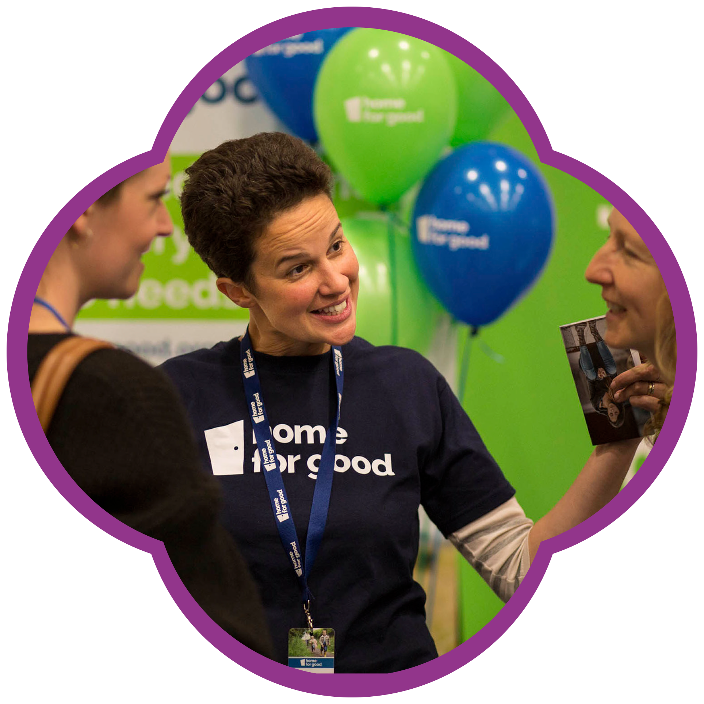

How we’re funded
The grants we give are generated from our ownership of Benefact Group, an international family of award winning, specialist financial services businesses – from advisory and investment management to broking and insurance
We’re in a privileged position to help others – all available profits from the Group fund our charitable giving
Built on the ethos of giving back, our funding model is distinctive and sustainable – enabling us to think long term and grow
Notes:
All information required is in the slide.

Slide 7

01452 875858
Get involved
Giving is at the heart of what we do. Visit our website, sign up for our quarterly newsletter and follow us on social media for new grant programmes and beneficiary success stories.
We achieve great things with our beneficiaries so please share our success!
benefacttrust.co.uk
benefacttrust
@benefacttrust
benefacttrust
Andrew Bass – Senior Grants Officer
andrew.bass@benefacttrust.co.uk
01524 782825 / 07391 861909
Notes:
Andrew Bass – Grants Officer for Scotland.
andrew.bass@benefacttrust.co.uk
01524 782825 or 07391 861909

Slide 8
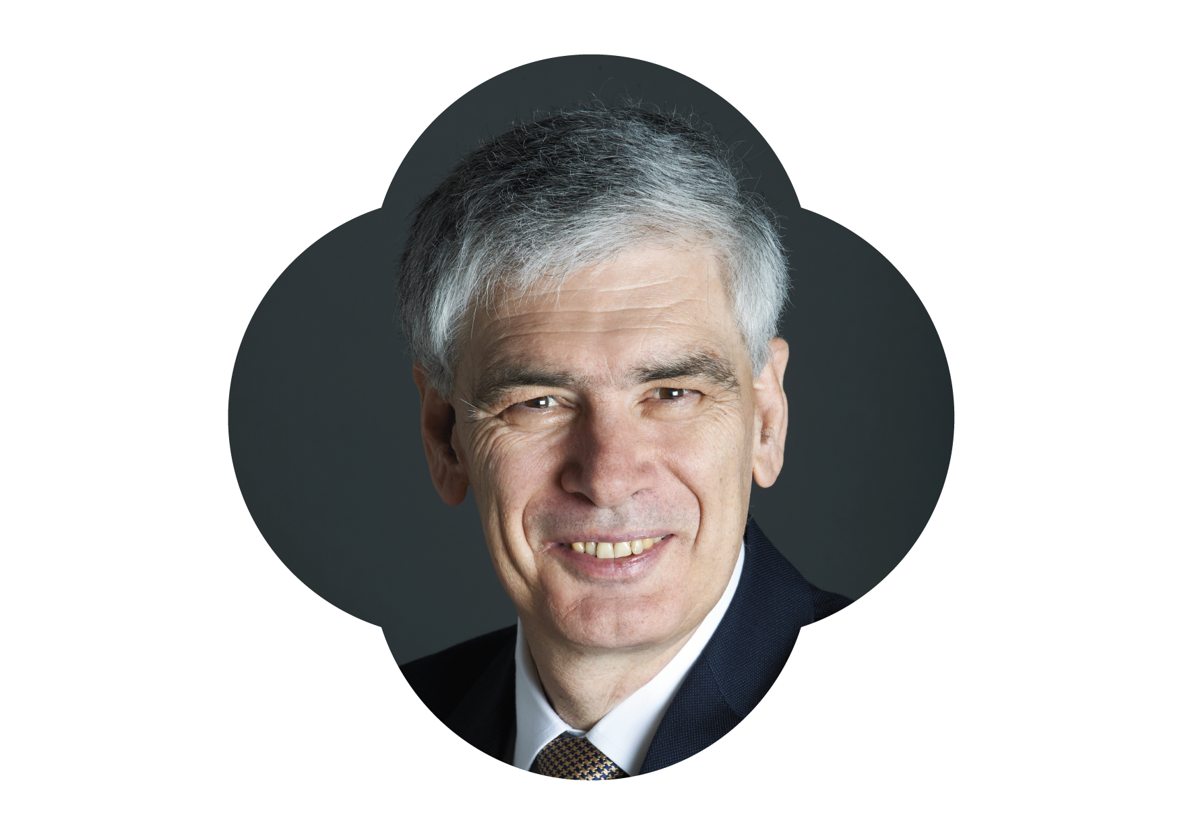
“Our aim at Benefact Trust is to equip and empower Christian organisations to have a positive and transformative impact on lives and communities. Giving is at the heart of who we are and what we do.”
Tim Carroll
Chairman Benefact Trust

