Slide 1





Business Energy Scotland
Scottish Episcopal Church
Amaka & Craig

Slide 2
Who we are
Funded by the Scottish Government.
We provide free, impartial support and access to funding to help small and medium-sized enterprises save energy, carbon and money.
We help businesses identify and implement energy saving projects.
Local support covering all of Scotland
Previously known as the Energy Efficiency Business Support Service, and now managed by Energy Saving Trust.

Slide 3
Why become more energy efficient?
Protect your profits from rising/volatile energy prices.
Growing demand from your customers to be green.
Start you business’s journey to net zero.

Slide 4
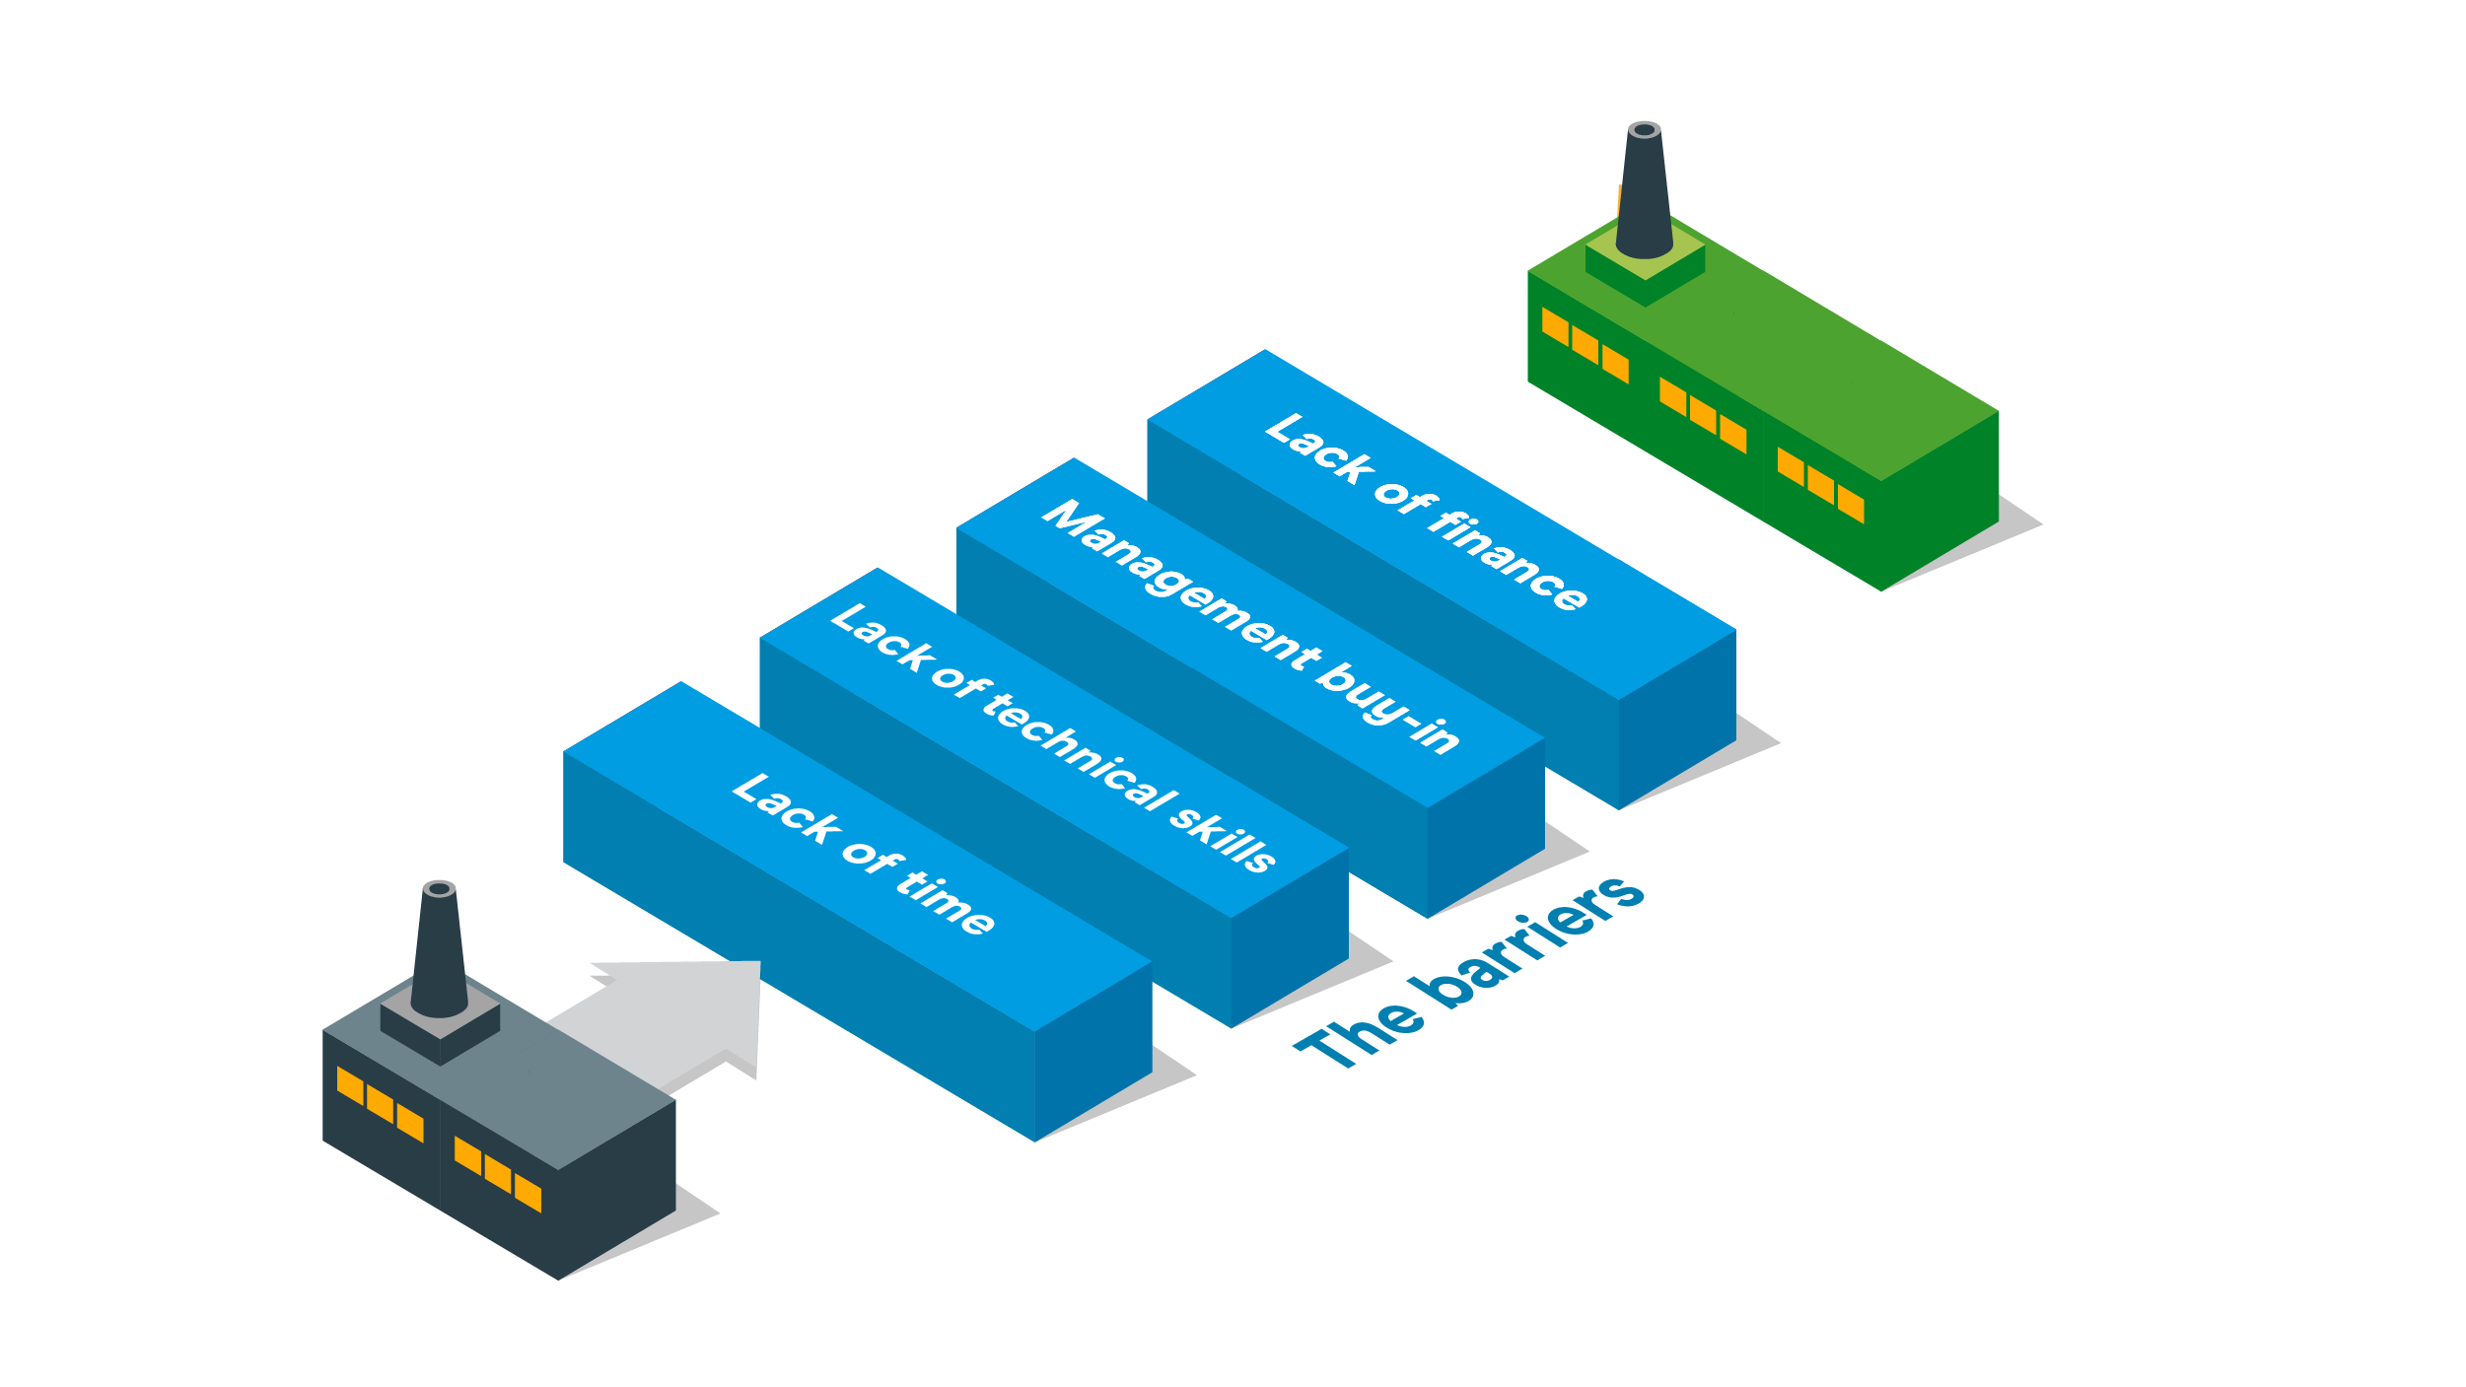

Slide 5
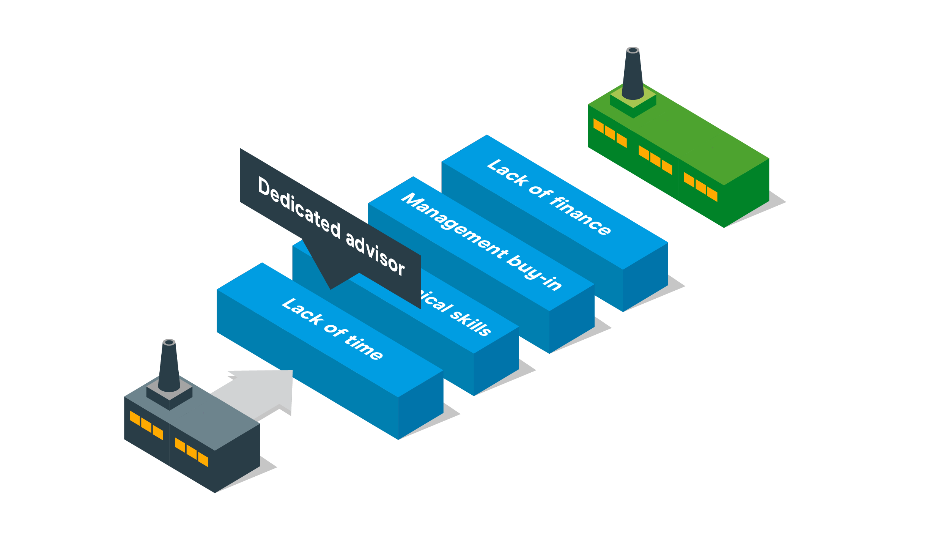

Slide 6
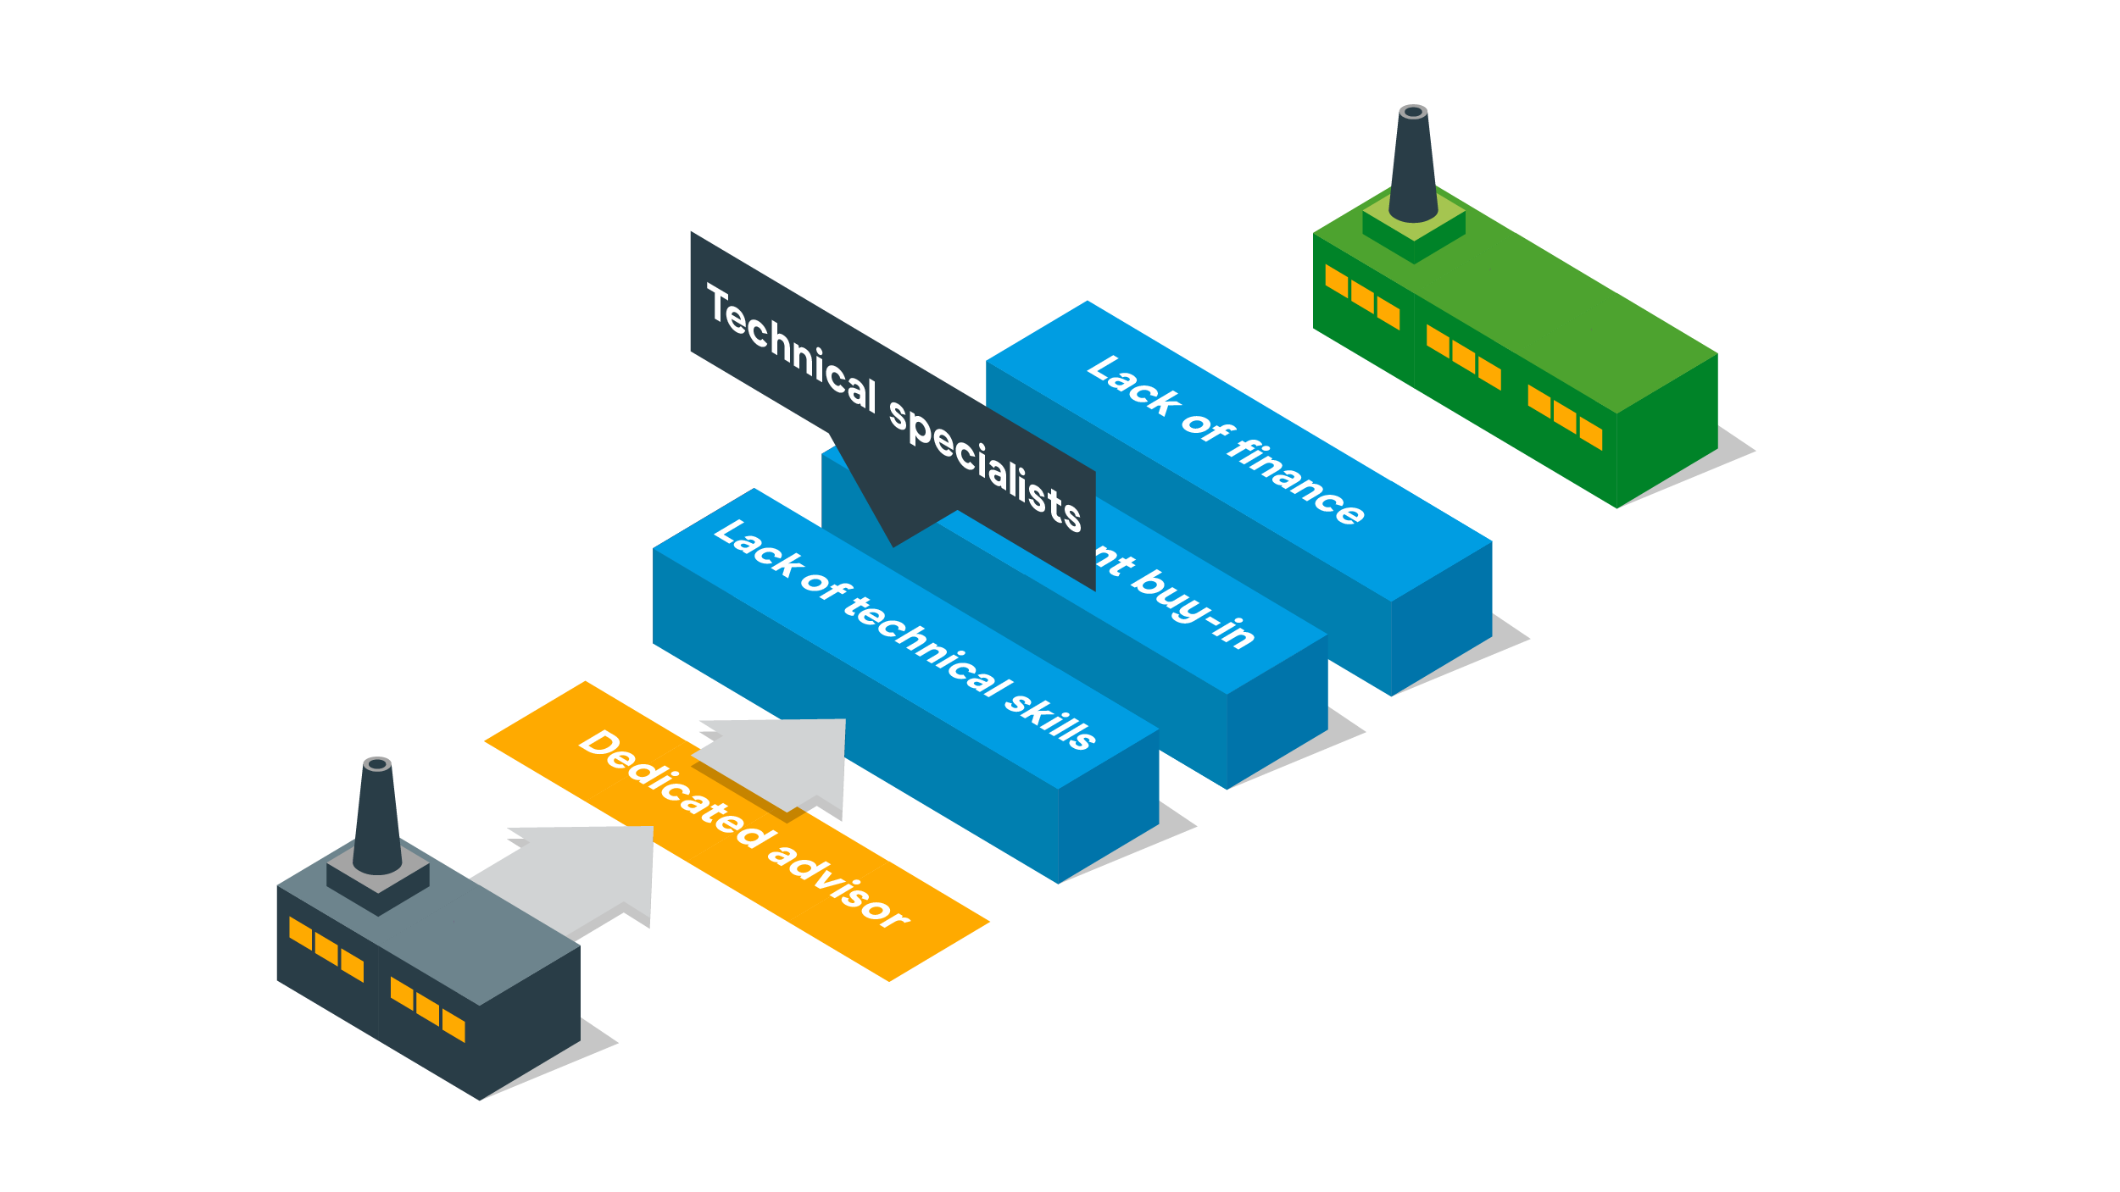

Slide 7
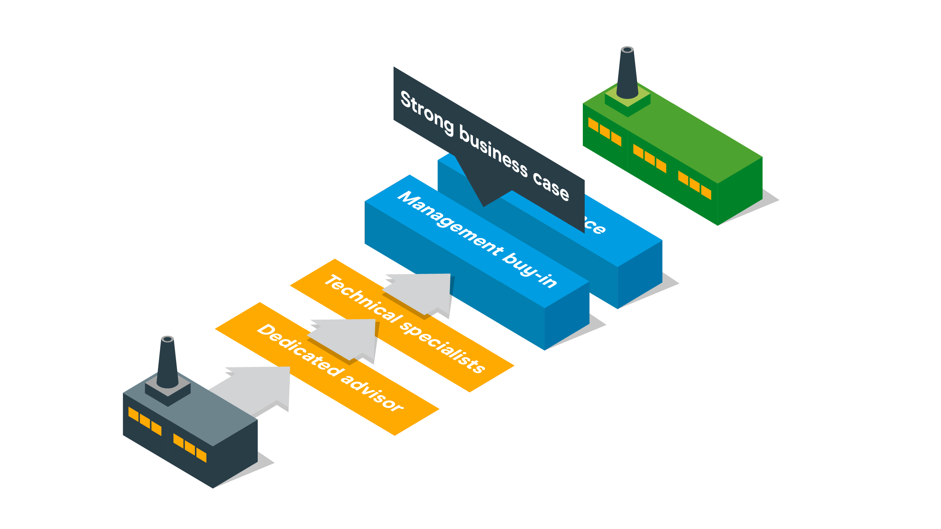

Slide 8
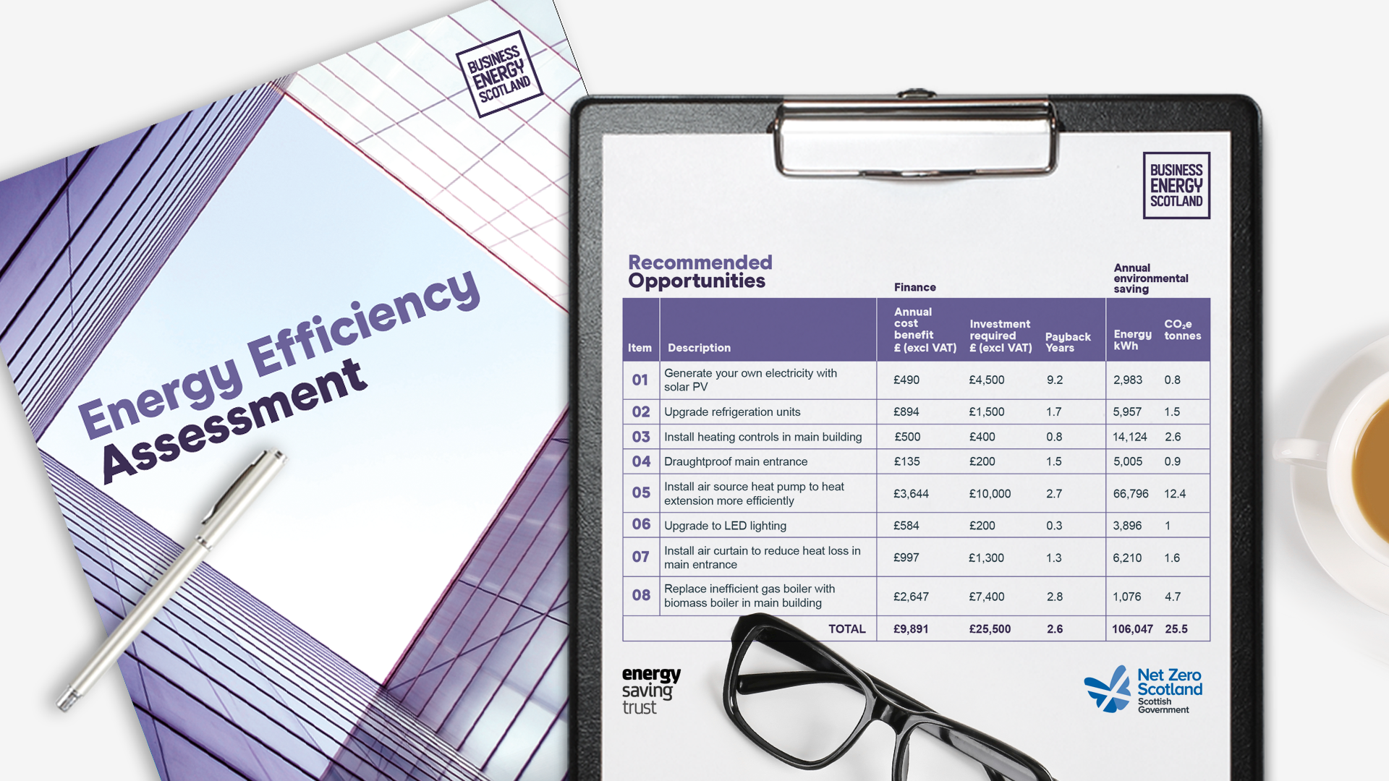
How much could you save?

Slide 9
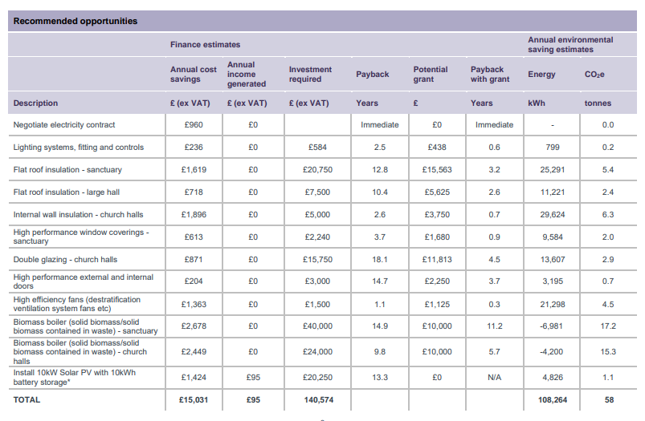

Slide 10
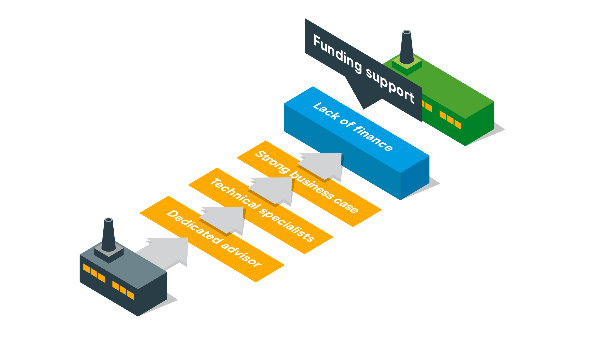

Slide 11
Scottish Government’s SME Loan Scheme
Funding for energy efficiency and renewables
1,000+
energy saving projects supported already
Interest free loans up to £100,000
Unsecured and no set up fee
Can be set against capital allowances
Eight year repayment
Available to Scottish SMEs trading for over 12 months
£26 million
worth of loans already provided
+ £30,000 cashback grant
on eligible measures upon project completion

Slide 12
EXAMPLE MEASURES | ENERGY EFFICIENCY Heating Lighting Ventilation Insulation Draughtproofing Double glazing Refrigeration BMS Voltage optimisation IT equipment | RENEWABLE HEAT Ground source heat pump Water source heat pump Air source heat pump Biomass boiler Solar thermal | OTHER RENEWABLES Wind turbine Micro-hydro Biomass room heaters (with radiators) Combined heat and power with biomass Anaerobic digestion
INTEREST RATE | 0% | 0% | 0%
CASHBACK GRANT | 75% | 75% | 0%
MAXIMUM CASHBACK | £20,000 | £10,000 | £0
LOAN VALUE | Up to £100,000 (with 8 year repayment)
+

Slide 13
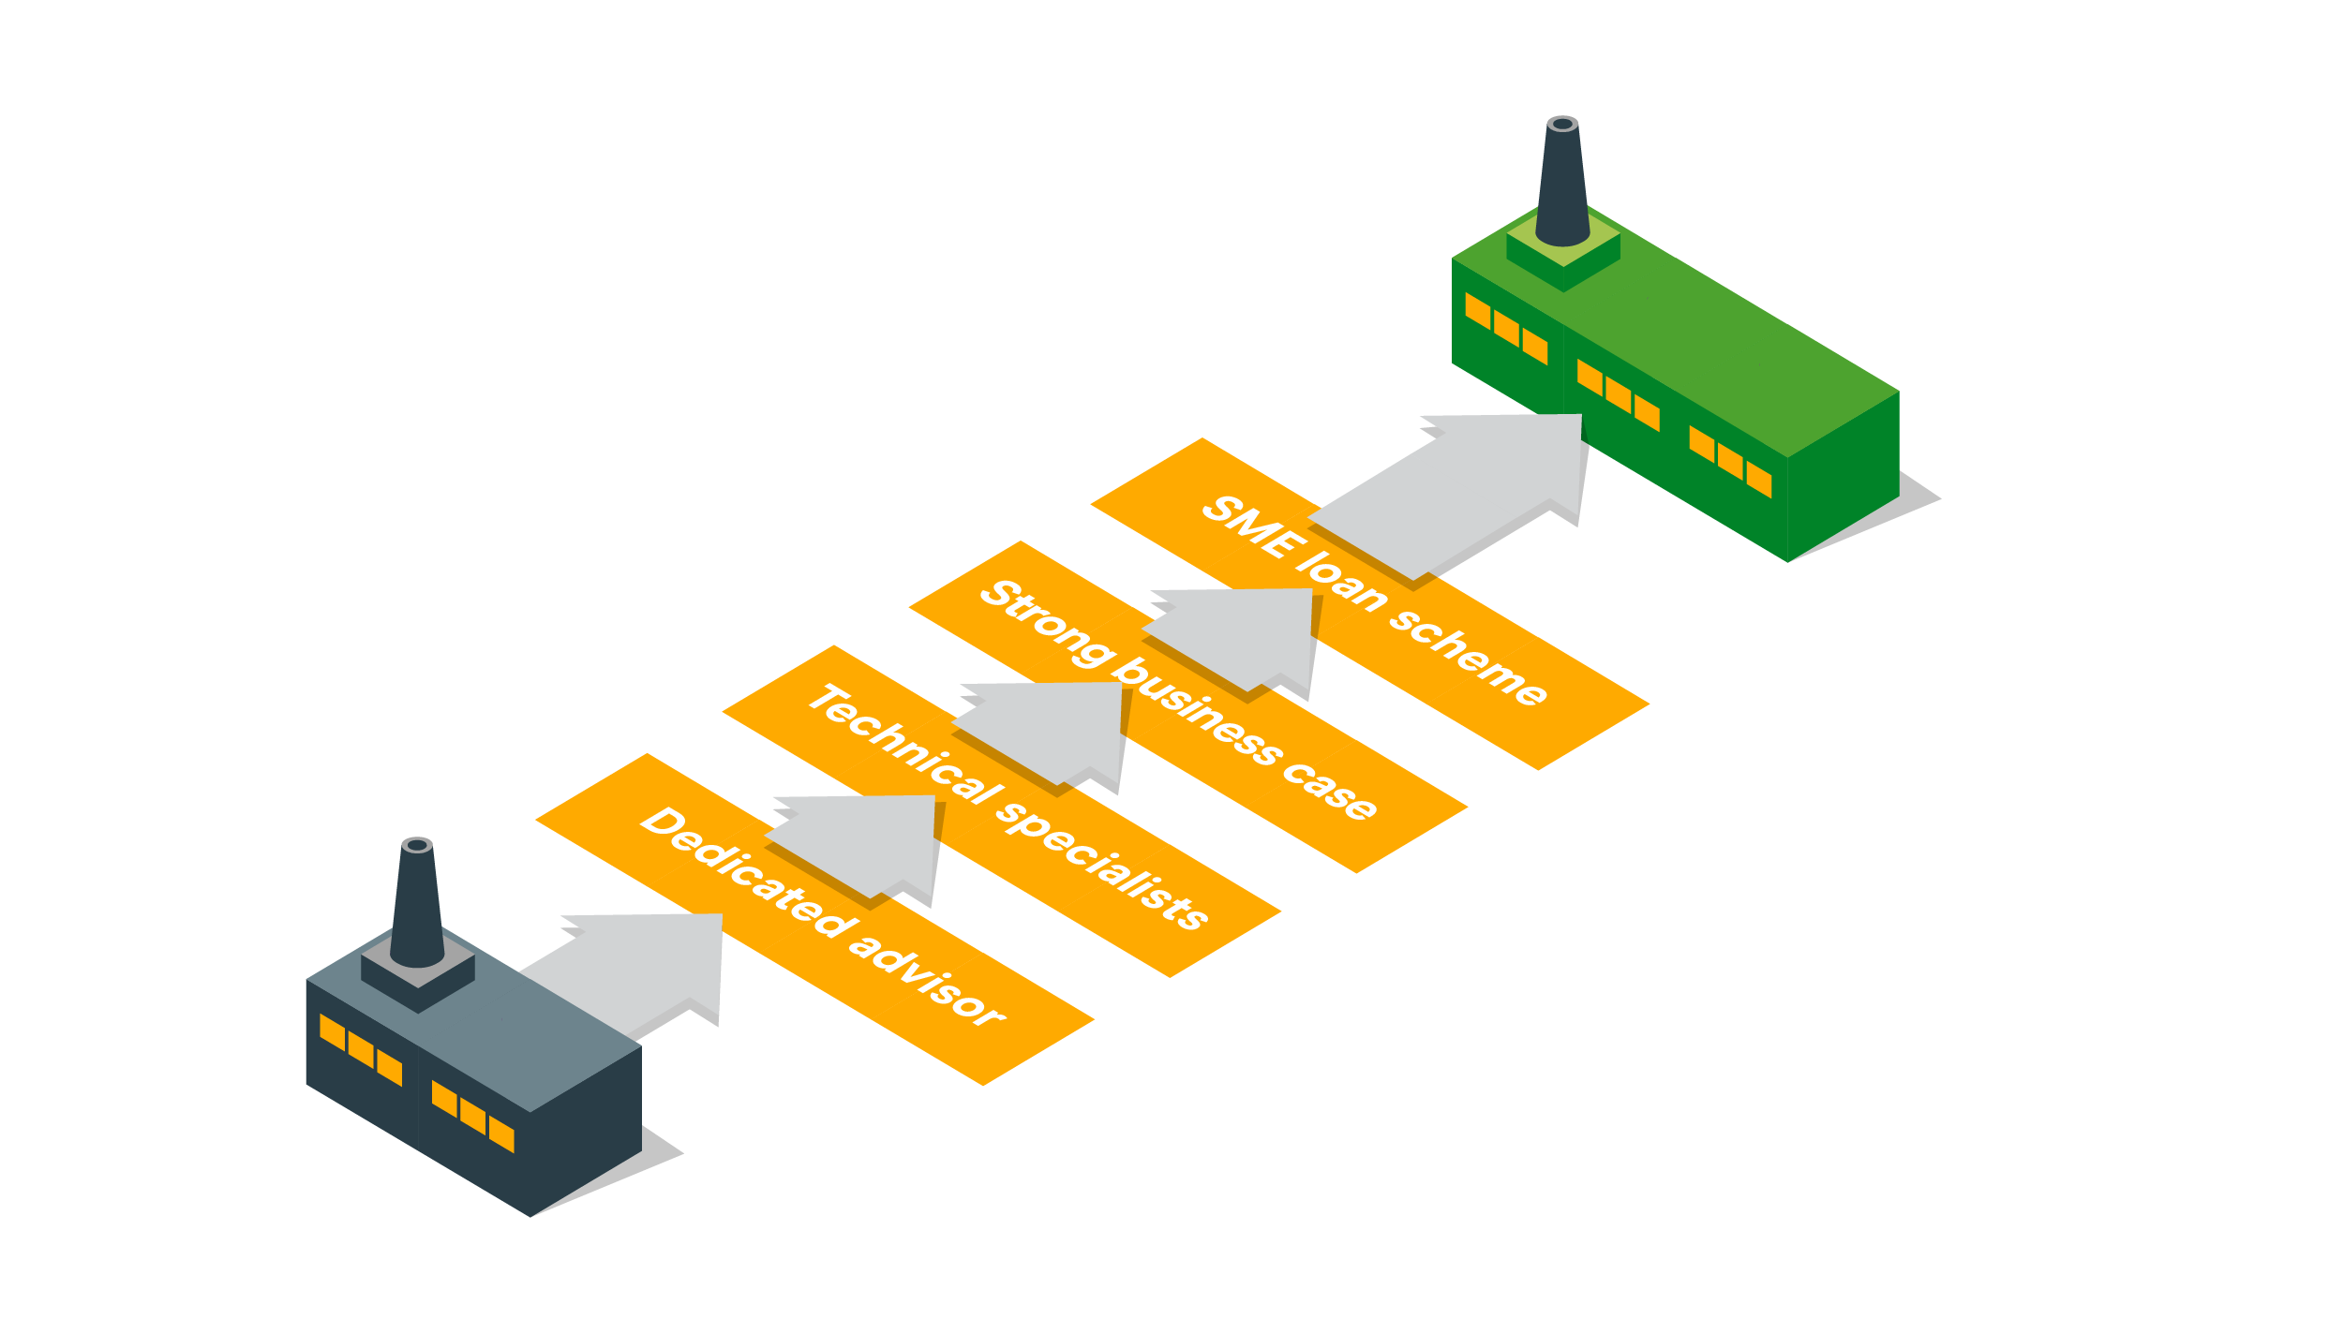

Slide 14


Delivering savings for Scottish SMEs
£££
£200
Million
24%
9/10
Savings identified
for businesses
Average energy
saving identified
9/10 customers recommend us

Slide 15
 | Support from Business Energy Scotland | Scottish Government SME Loan Scheme
Location | Premises in Scotland
Employees | Fewer than 250 full time equivalent employees
Turnover | Turnover not exceeding €50 million (approximately £42 million) and/or Balance sheet total not exceeding €43 million (approximately £36 million)
Trading start | A registered enterprise of any age | Trading for 12+ months and can supply at least one set of annual accounts if requested
Ownership | If part of a group, the group qualifies as an SME | Less than 25% owned by one or more other enterprises and itself has a holding of less than 25% in any other enterprise
Credit score | Not checked/ not applicable | Has a satisfactory credit score and able to afford repayments
Project status | Can provide support at any stage | Not start work prior to the loan offer being made
Referral via portal

Slide 16
Key energy efficiency improvements to consider for your church

Slide 17
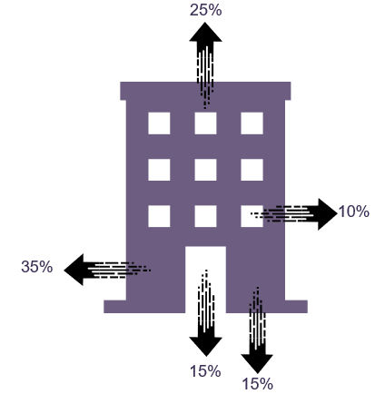
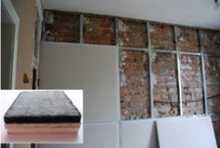
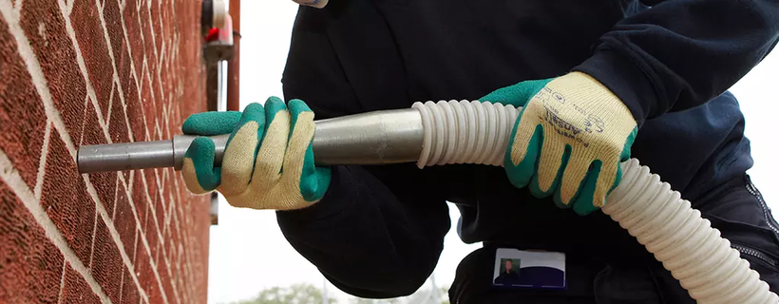
Key opportunities for church buildings
Insulate walls
External: ~£100/m²
Internal: £17-125/m²
Cavity:
£22-£26/m²
Solid
Cavity

Slide 18
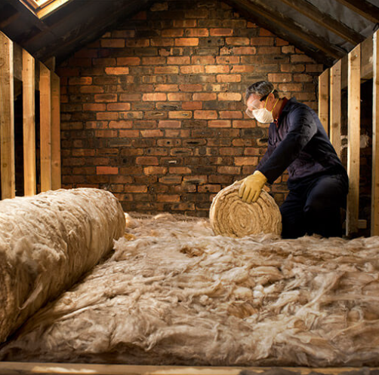
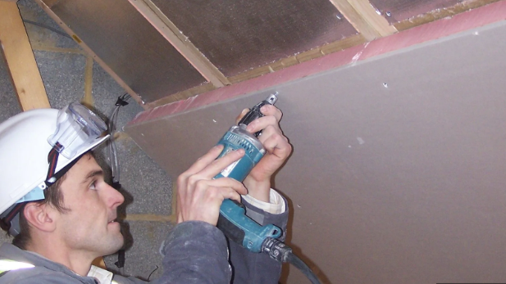
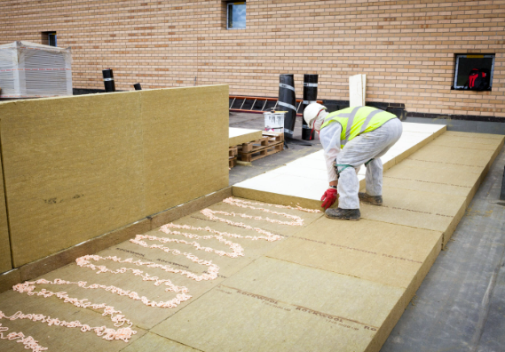
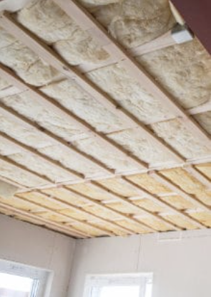
Key opportunities for church buildings
Insulate roofs
Standard pitched roof:
~£10/m² self-install
~£10/m² pro-install
Vaulted ceiling: £20-30/m²
Flat roof: £25-35/m²

Slide 19
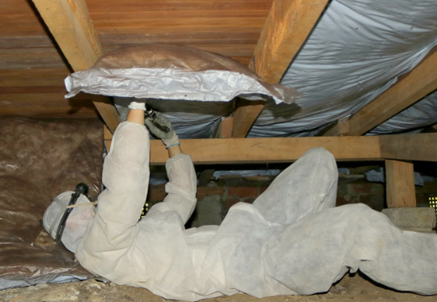
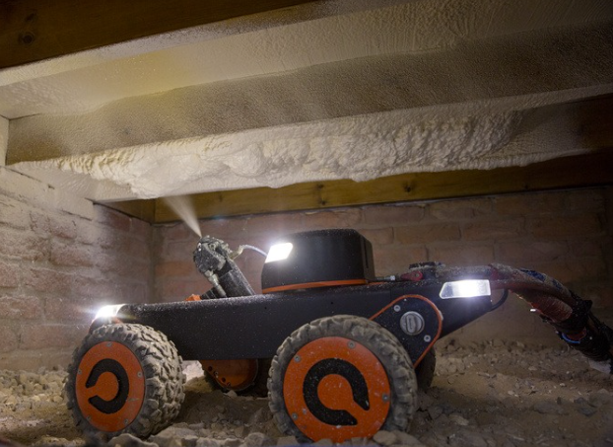
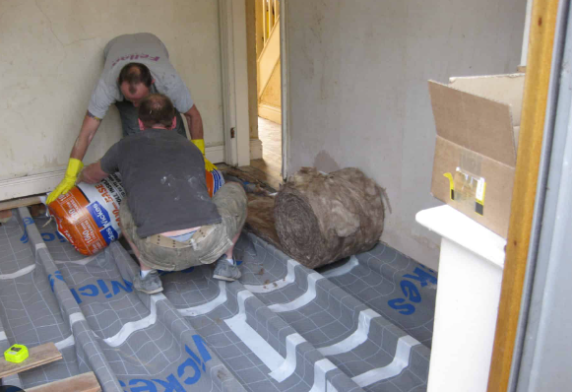
Key opportunities for church buildings
Insulate floors
Susp
Timber:
~£95/m²
Q-Bot:
£75-£150/m²
Solid:
~£70/m²

Slide 20
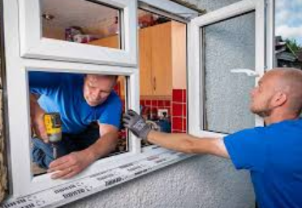
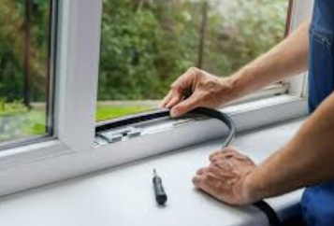
Key opportunities for church buildings
Improve glazing, doors & draughtproof
Double:
£300-500/m²
Secondary:
£150-300/m²
Draught-
proofing:
£85 – £275 per site

Slide 21
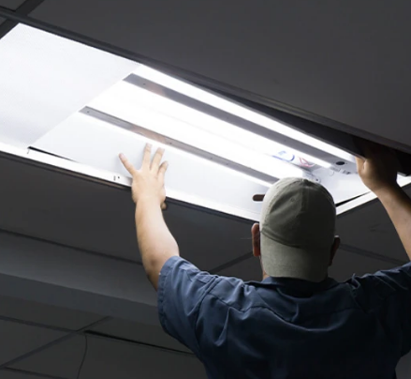

Key opportunities for church buildings
Upgrade lighting to LEDs with the right controls
Commercial
LED lights:
£20-50/lamp
Electrician:
£150-200/day
Savings of up to 80%

Slide 22
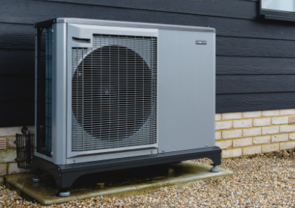
Key opportunities for church buildings
Upgrade heating system to a low carbon alternative
Air Source Heat Pump:
£6,500 to £11,500/unit
Typically, over 300% efficient

Slide 23
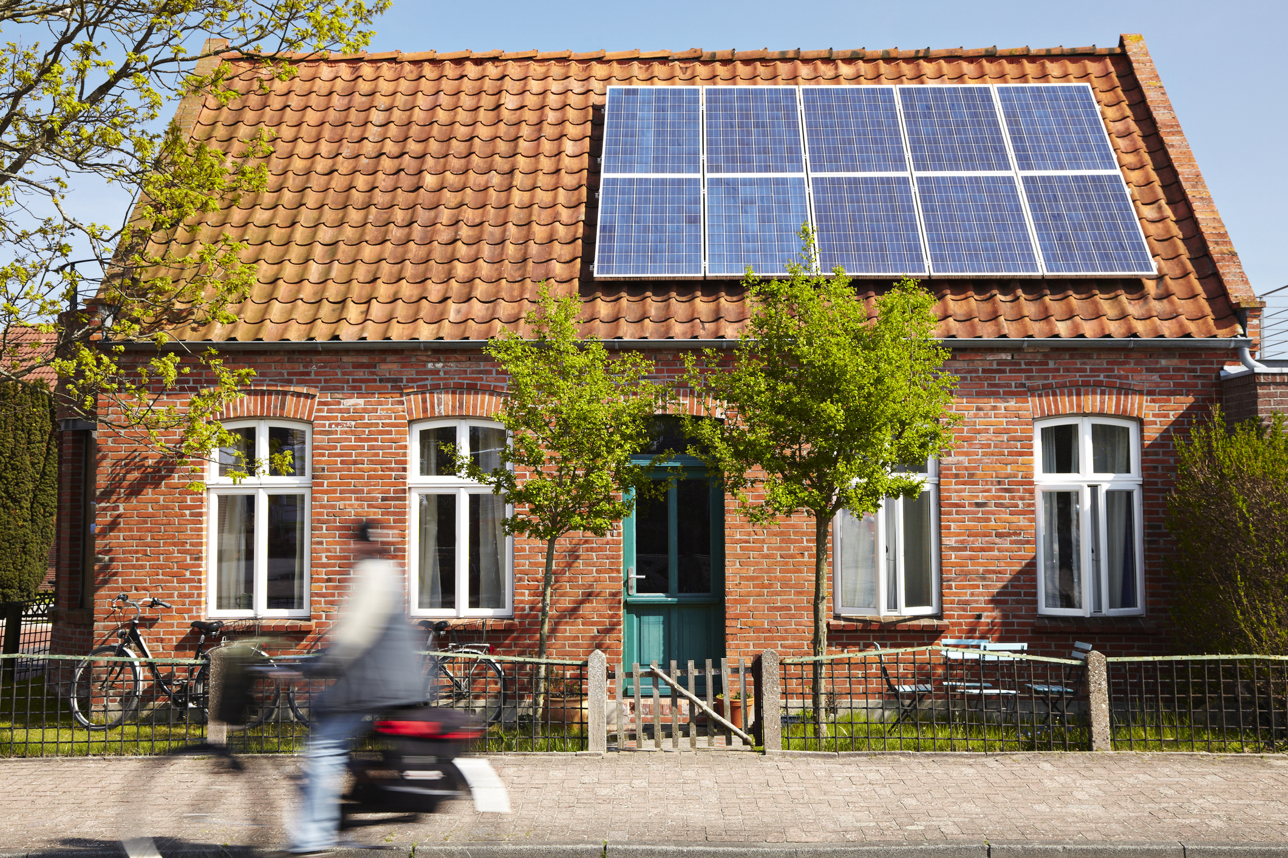
Key opportunities for church buildings
Generate your own electricity with solar PV
~£1,250 per kW of panels
~£1,500 per kW
Of battery storge
3.5kW solar PV system

Slide 24
Implement energy efficiency behaviours
Review your energy tariffs and negotiate the best deal
Monitor your energy consumption – you can't manage what you don't measure
Attend Green Champions training

Slide 25
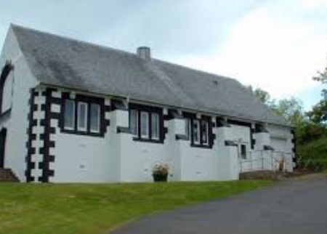
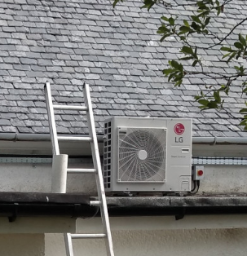
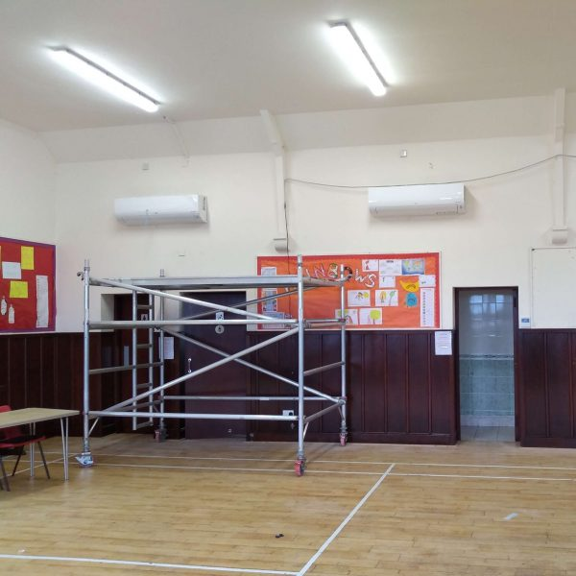
Case study: Shiskine Hall, Isle of Arran
Annual savings of 1.7 tonnes of cO² and £1,060 on fuel
“Without the support and funding from the SME Loan Scheme, we would not have been able to afford to install the new heat pumps. The hall committee is pleased to be promoting energy efficiency and doing what we can to help our community be sustainable in the light of the ongoing concerns about climate change.”

Slide 26

Local Energy Scotland
CARES Funding
Community development
Shared ownership projects
Free and impartial advice
https://localenergy.scot/

Slide 27

Free online help
CPD-certified Green Champions training
Energy saving tools and guides
Skills development webinars
Staff engagement toolkit
https://businessenergyscotland.org/summary-resources/

Slide 28

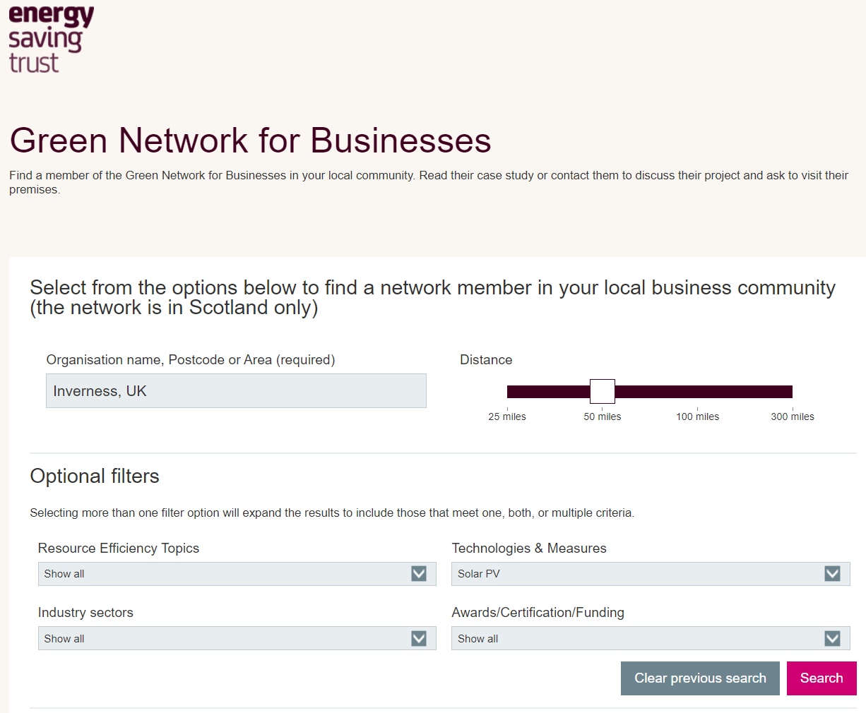
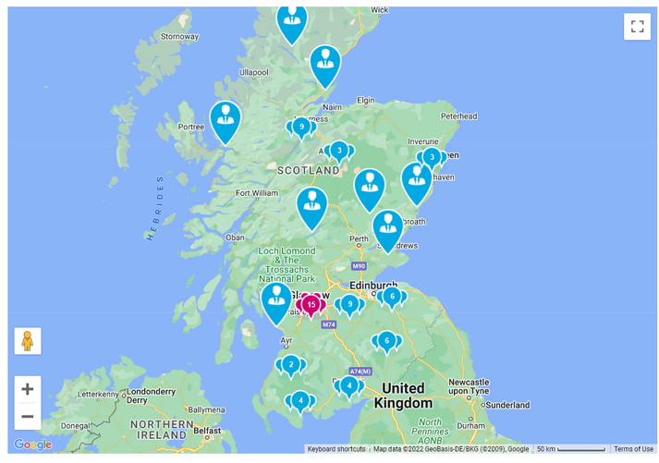
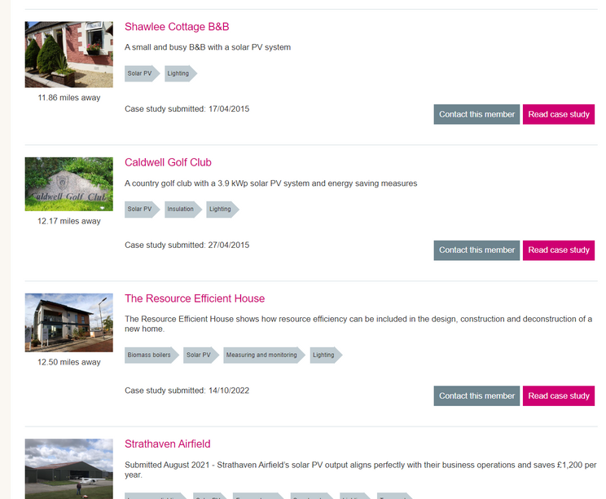


Presented by
Clare Carden
BSc, PhD, CEng, MEI, CEM-I

Slide 29


Start saving today
Use our free website resources and training events at businessenergyscotland.org
Call our friendly advisors on 0808 808 2268
Business Energy Scotland
@busenergyscot

Slide 30
Questions?
Business Energy Scotland
@busenergyscot

