Slide 1

Notes:
What will we cover?
- Who we are
- Our success story
- The climate crisis
- How you can help

Slide 2
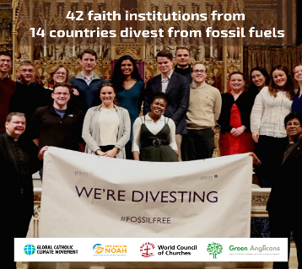
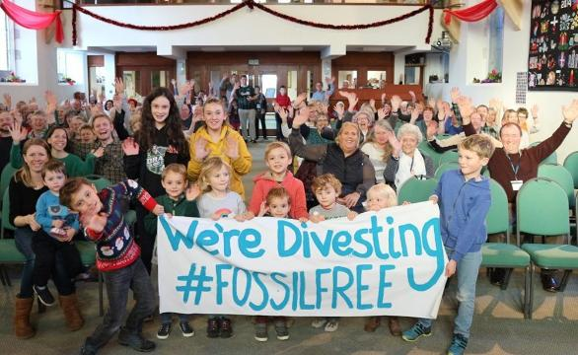
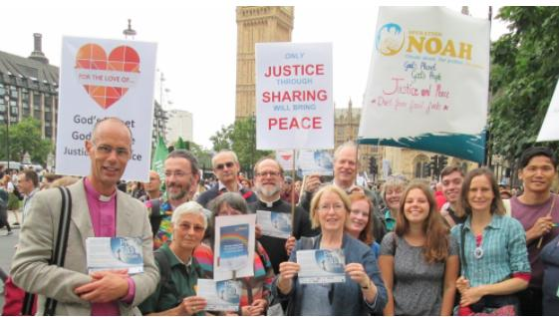
Inspiring the church to take action on the climate crisis
Notes:
Operation Noah is a Christian charity working with the Church to inspire action on the climate crisis - providing leadership, focus and inspiration in response to the growing threat of catastrophic climate change.
We work with all Christian denominations and support interfaith work on climate change. Our vision is of a world where people live sustainably, in harmony with the planet:
History of Operation Noah & why formed:
Operation Noah was set up by Green Christian and Churches Together in Britain and Ireland in 2004 to provide a Christian response to the climate crisis.
Explain:
How did you get involved yourself
Top picture: meeting of the meeting of the Conference of Religious on divestment at London Jesuit Centre in February 2019
Bottom picture: Members of the congregation at Ivybridge Methodist Church, Devon, celebrate their divestment commitment

Slide 3
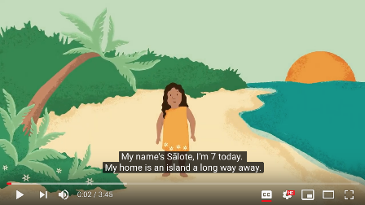
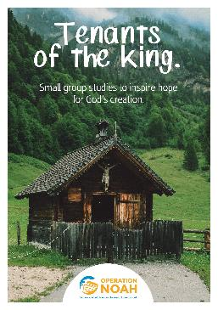
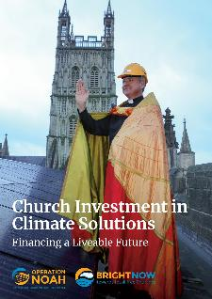
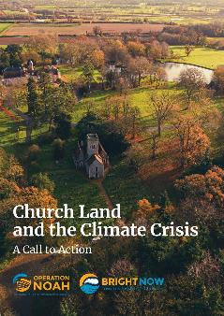
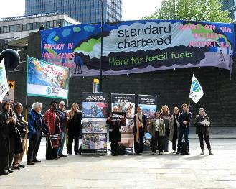
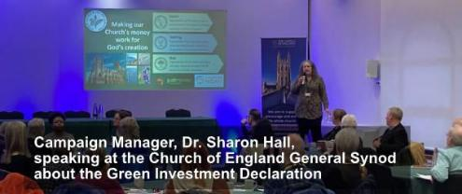

What do we do?
Notes:
Operation Noah is a Christian charity working with the Church to inspire action on the climate crisis - providing leadership, focus and inspiration in response to the growing threat of catastrophic climate change.
We work with all Christian denominations and support interfaith work on climate change. Our vision is of a world where people live sustainably, in harmony with the planet:
History of Operation Noah & why formed:
Operation Noah was set up by Green Christian and Churches Together in Britain and Ireland in 2004 to provide a Christian response to the climate crisis.
Explain:
How did you get involved yourself
Top picture: meeting of the meeting of the Conference of Religious on divestment at London Jesuit Centre in February 2019
Bottom picture: Members of the congregation at Ivybridge Methodist Church, Devon, celebrate their divestment commitment

Slide 4
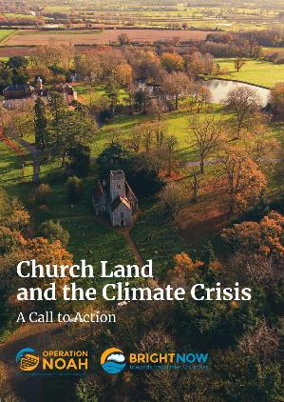
Thriving Biodiversity:
Caring for God’s Creation
Alongside our Net Zero agenda for the urgent climate action we need, we are facing another crisis in biodiversity. How can we tackle these together?
Notes:
The Background to ‘Faith Motivated – Hope Inspired – Science Informed’

Slide 5
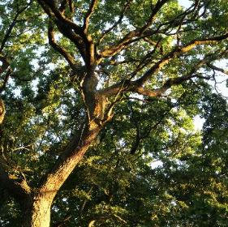
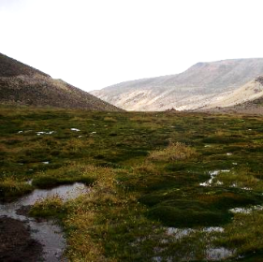
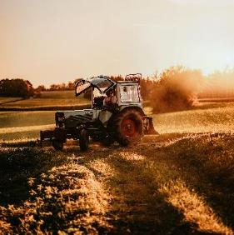
Interventions on church land to reduce carbon emissions can also boost biodiversity:
Growing trees
Protecting peatland
Supporting farmers to reduce emissions
Notes:
Trees - not monoculture, mainly native trees. Enhance habitats
Peat - don’t grow trees on peat.
Farmers - not monoculture, avoid biofuels and BECCS (Drax etc Bioenergy with Carbon Capture and Storage - Energy System - IEA)

Slide 6
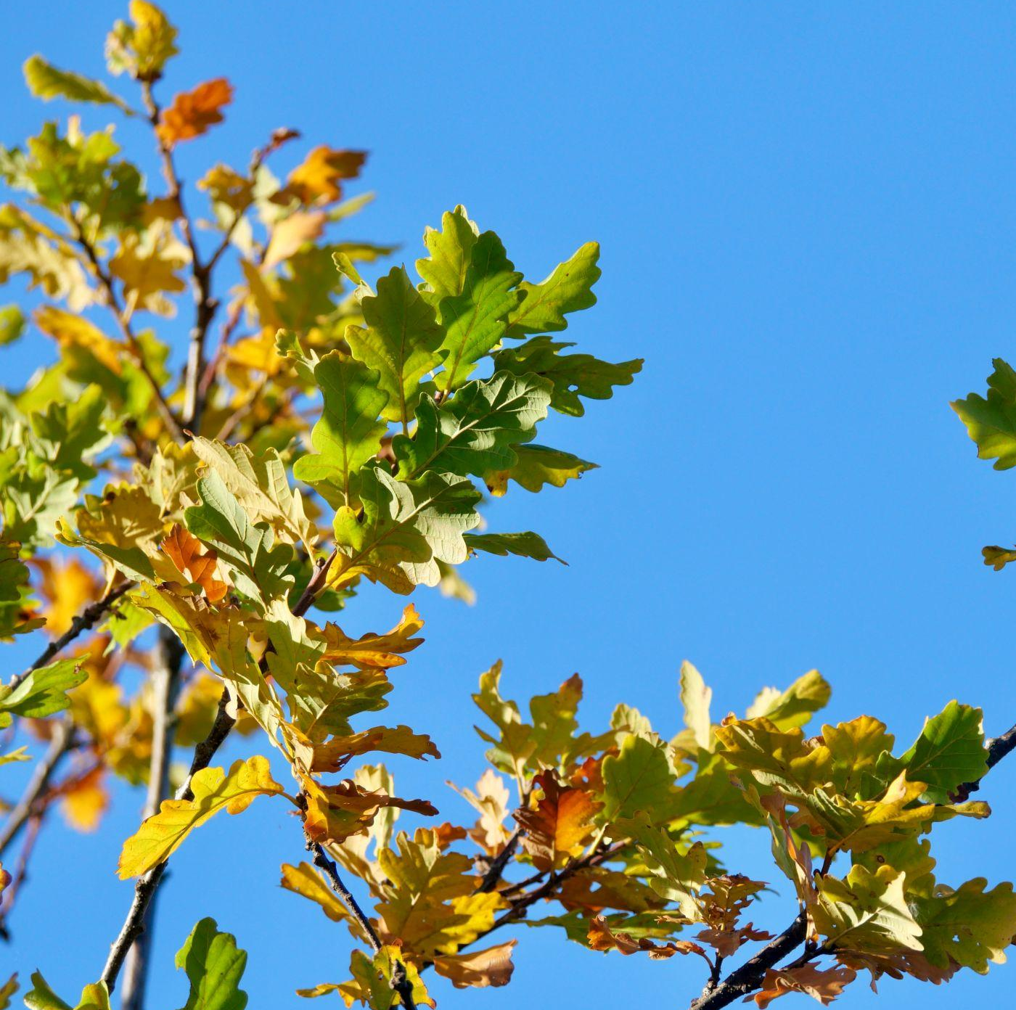
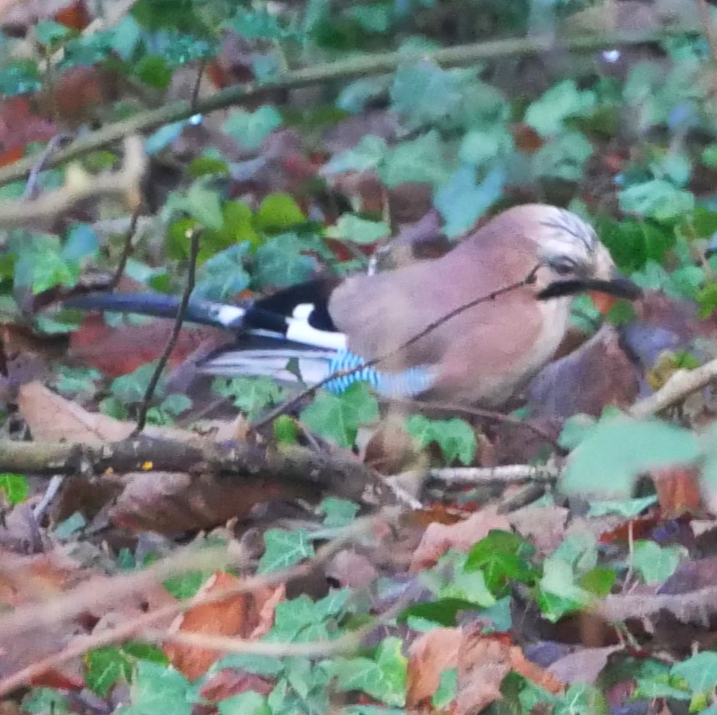
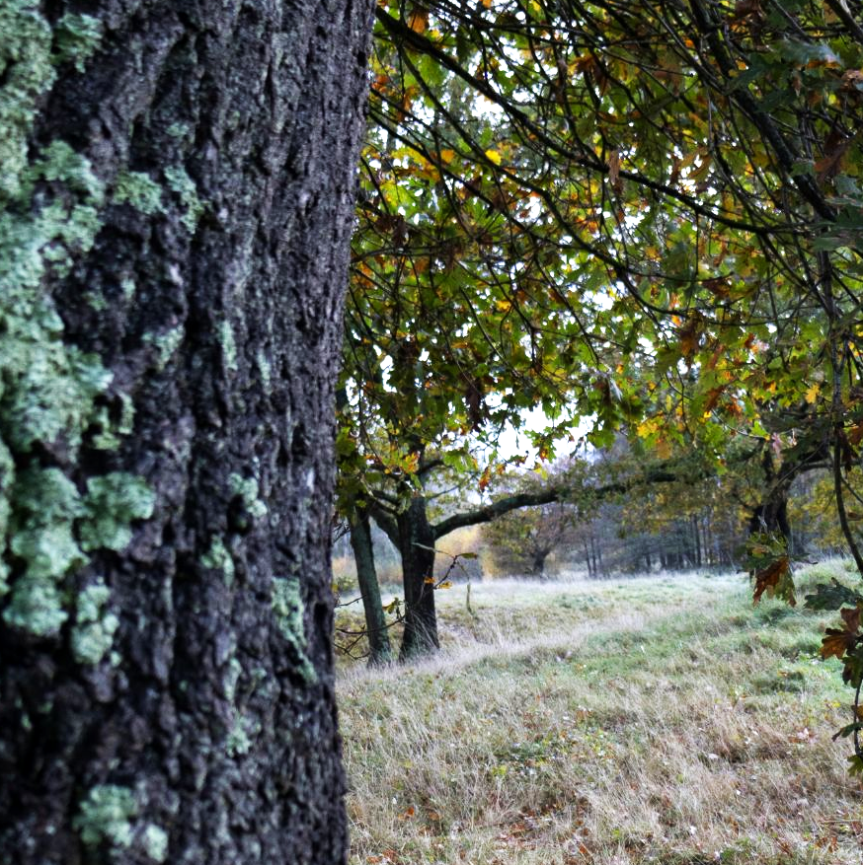

Growing Trees
The right trees in the right places can support huge biodiversity, as well as capturing carbon, reducing flood risk and providing shade.
Oak trees are the UK's most important tree for biodiversity, supporting around 2,300 species, consisting of 38 bird species, 229 bryophytes, 108 fungi, 1178 invertebrates, 716 lichens and 31 mammals (Action Oak).
We are encouraging Episcopal dioceses to join in the Communion Forest, growing trees, protecting forests and ecosystems.

Slide 7
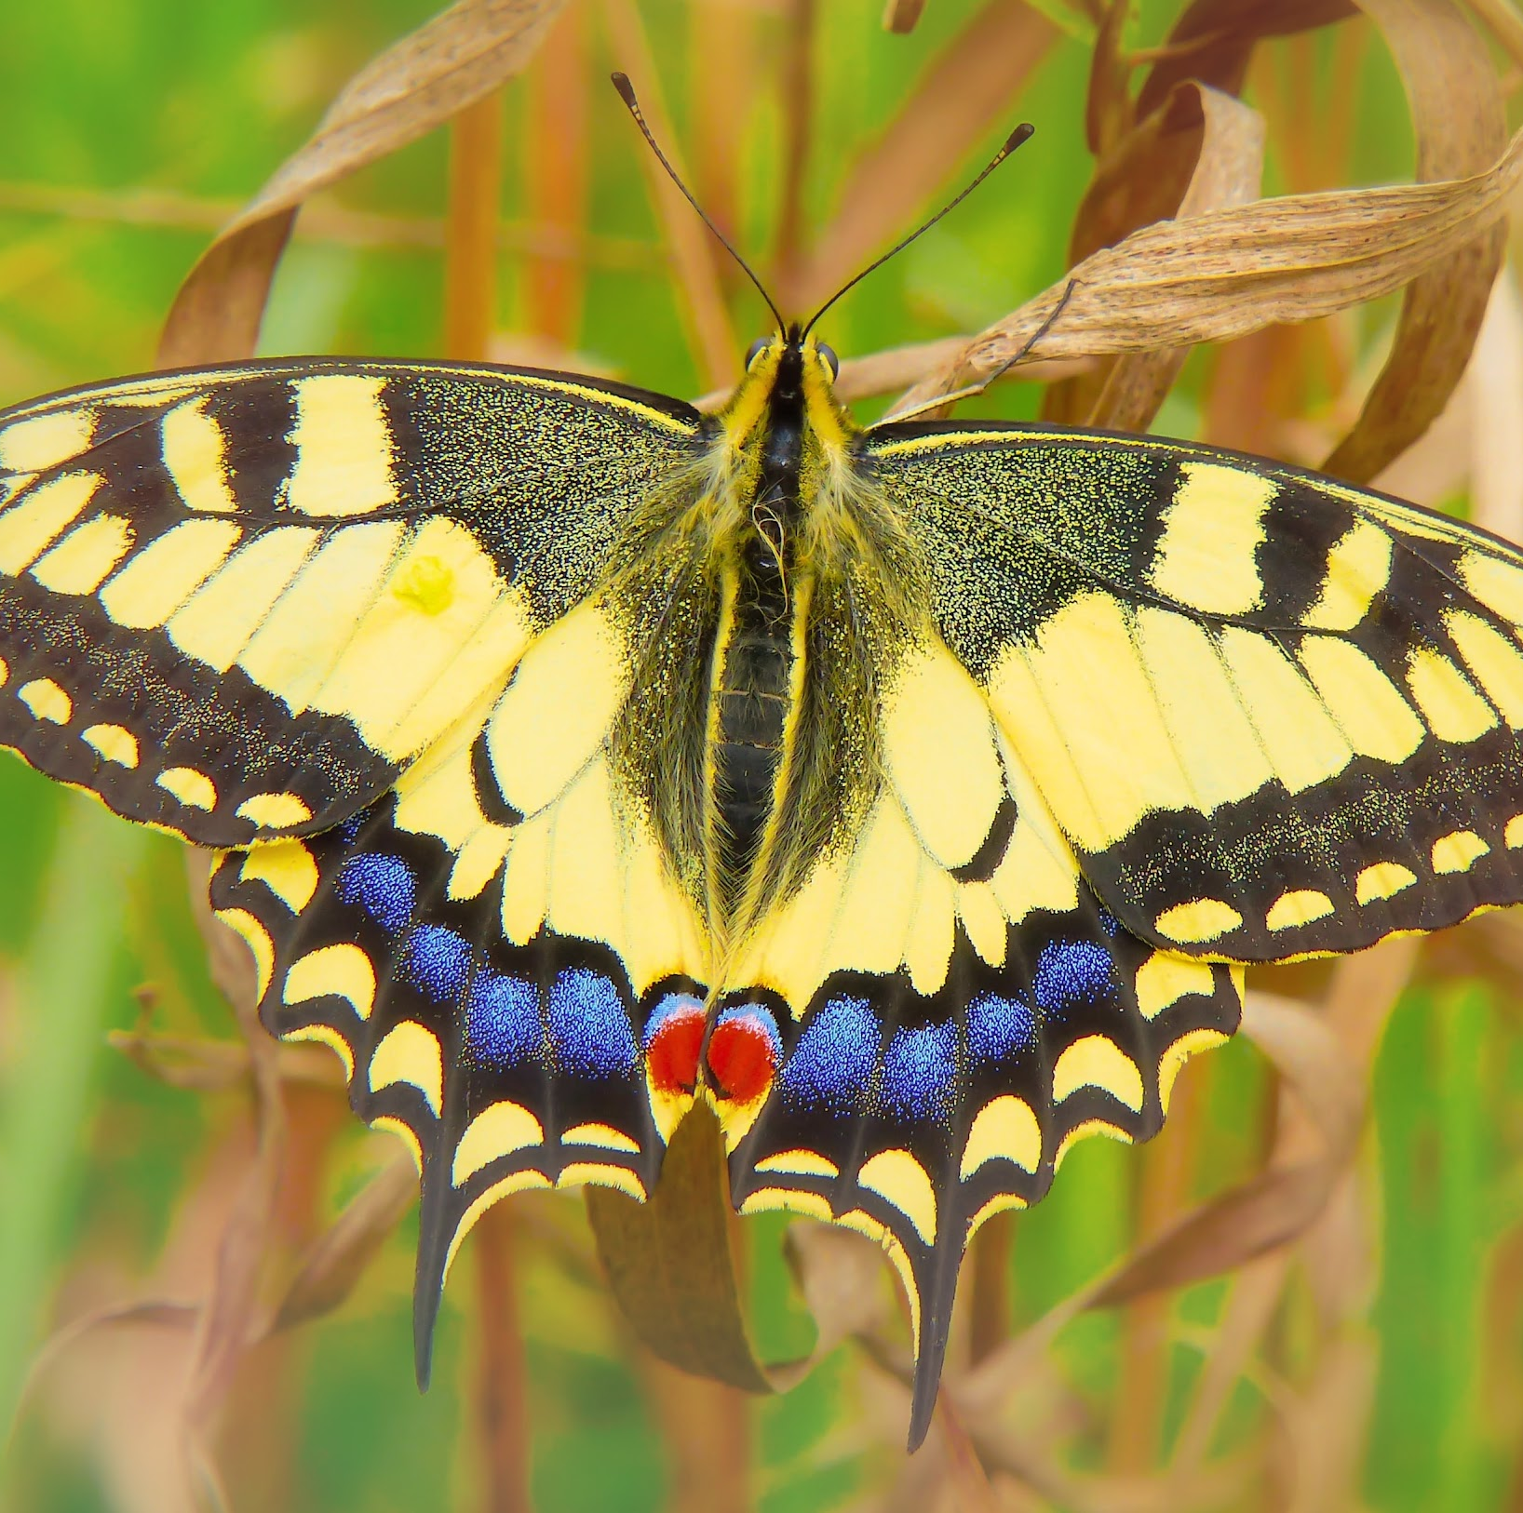
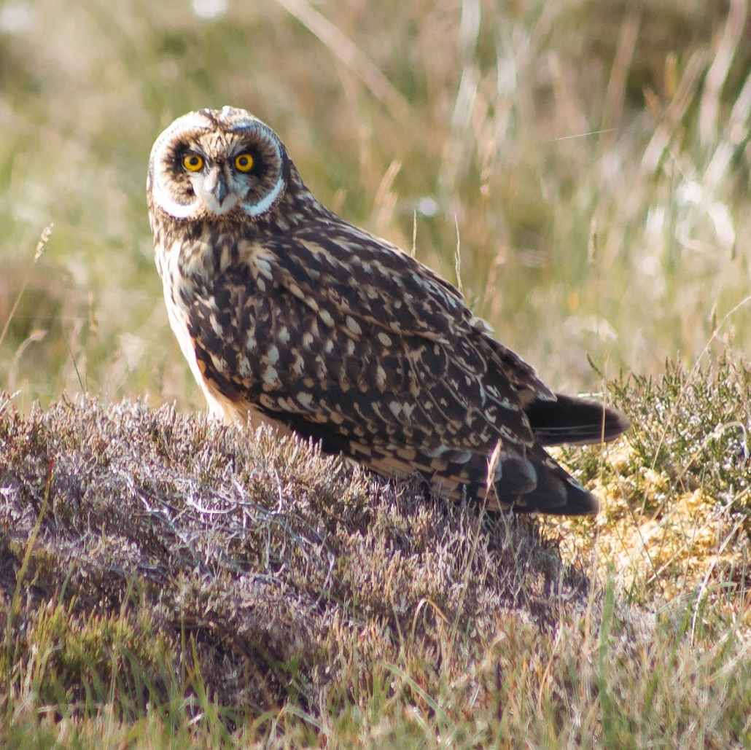
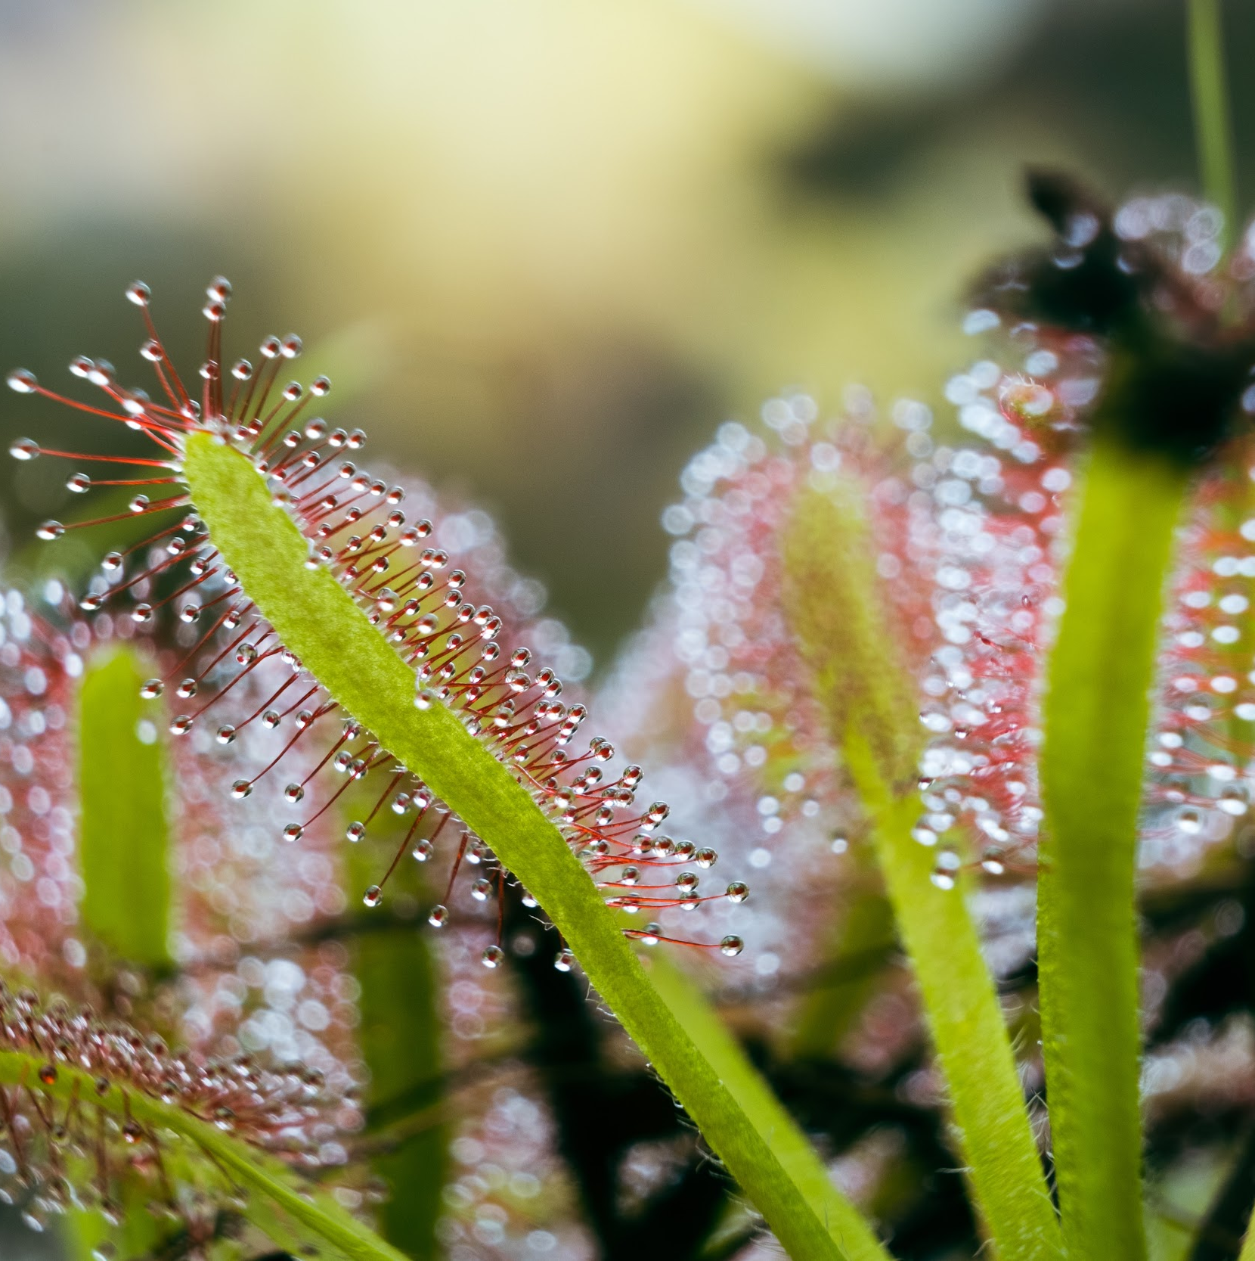
Restoring and Protecting Peatland
Healthy peatland supports biodiversity including rare bitterns, short-eared owls, swallowtail butterflies, sundews and sphagnum mosses.
Nearly a third of UK deep peat is protected as Sites of Special Scientific Interest.
Rewetting peatland can stop it from being a major source of carbon dioxide and methane emissions.
Other practical benefits of healthy peatland include supporting water cycles, controlling pollution and flood resilience.

Slide 8
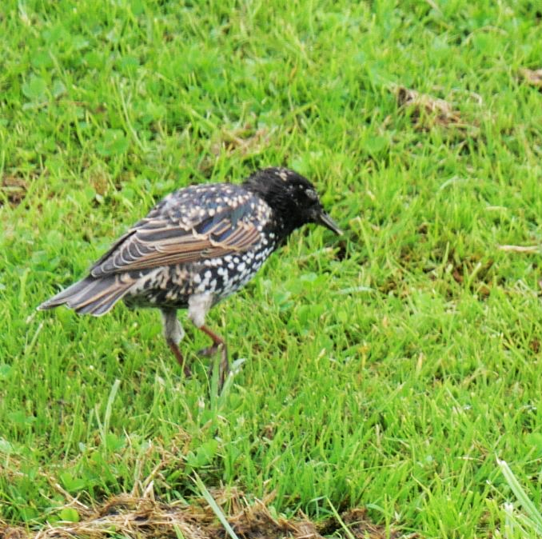
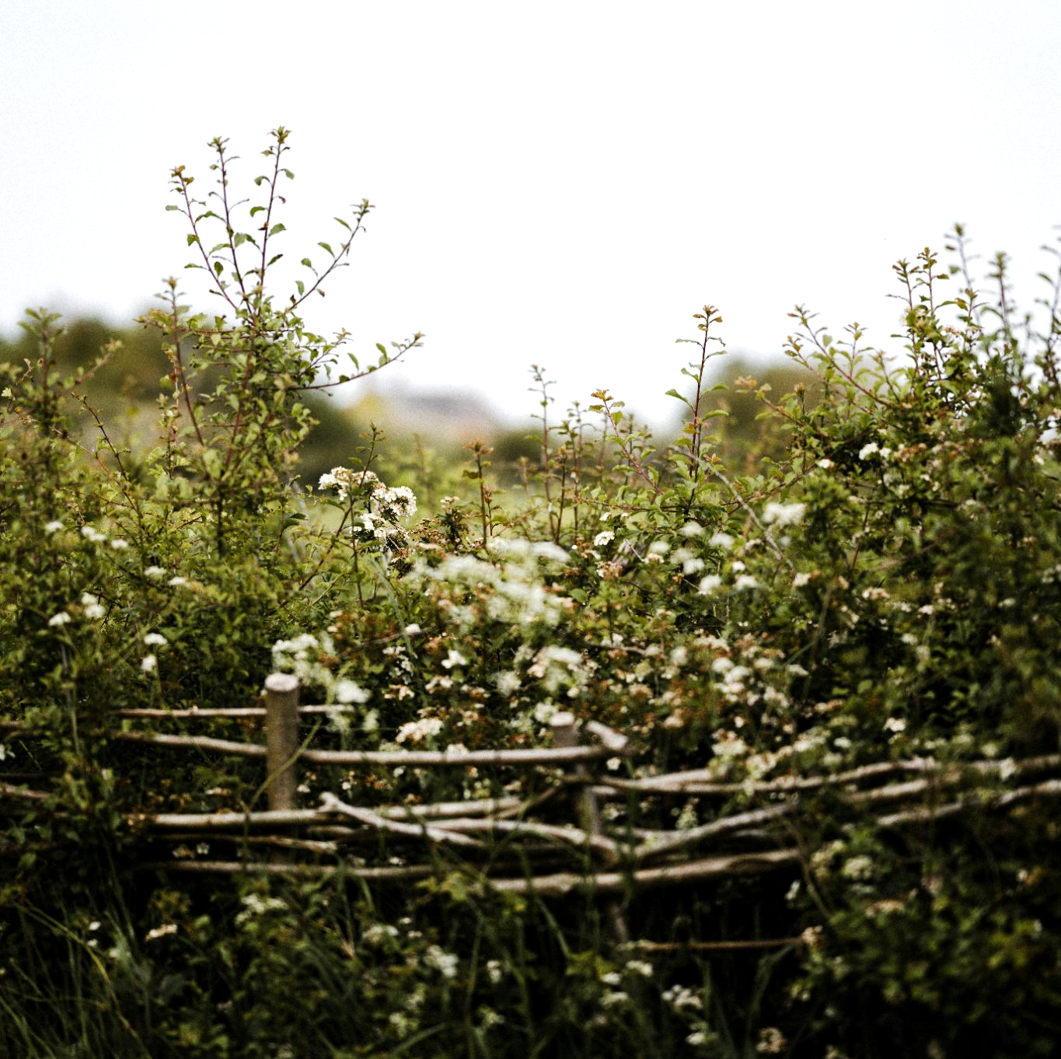
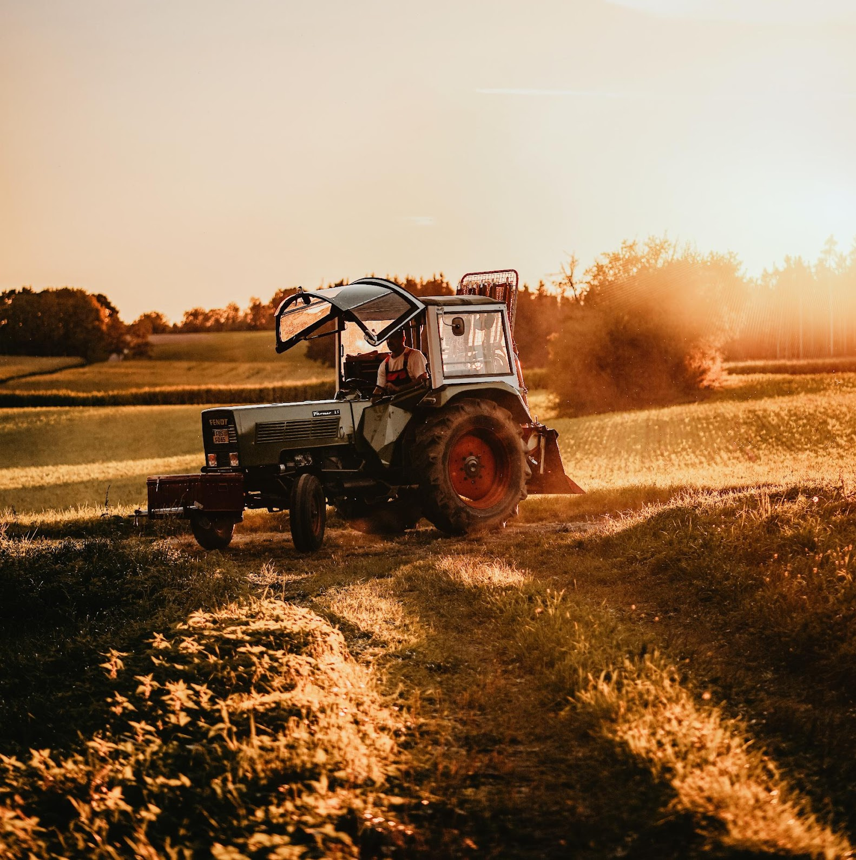
Reduce farmland emissions
Farmland bird populations have declined by 62% since 1970, with declines being stronger for farmland specialist birds than generalists. Farmland birds in strong long-term decline include turtle dove, grey partridge, corn bunting and starling. (JNCC)
Cuts to pesticides and artificial fertilizers allow renewed biodiversity including vital pollinators.
Other nature-friendly farming techniques include crop rotation, field-margin management and increasing hedgerows.

Slide 9


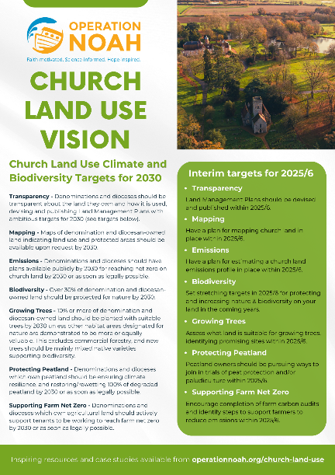
CHURCH LAND USE VISION
Transparency
Mapping
Emissions
Biodiversity
Growing Trees
Protecting Peatland
Supporting Farm Net Zero
7 target areas
operationnoah.org/church-land-use

Slide 10
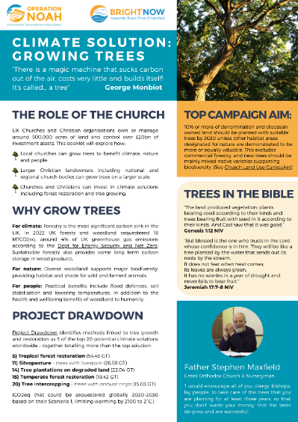
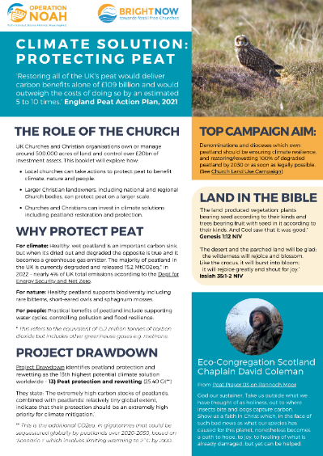
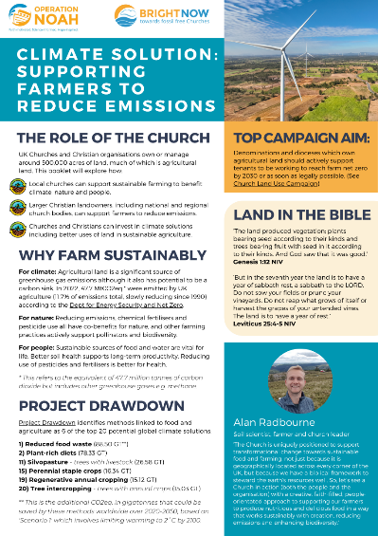
RESOURCES:
ON TREES, PEAT, FARMING

Slide 11
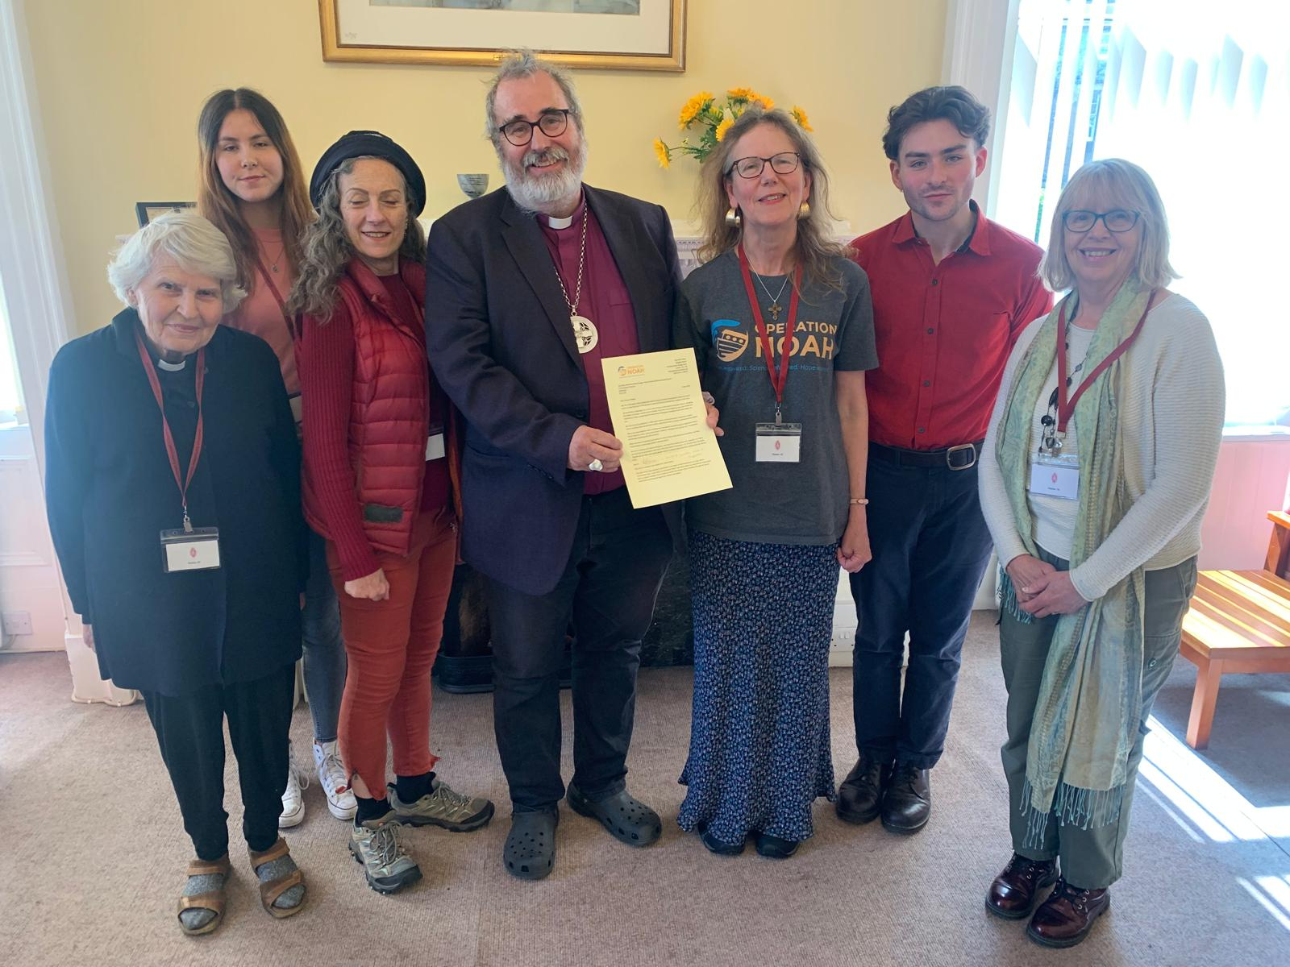
Open letter to national church leaders
500+ Christians have signed
Including examples of local action and inspiring projects

Slide 12
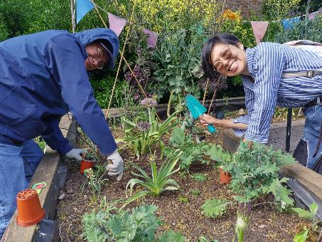
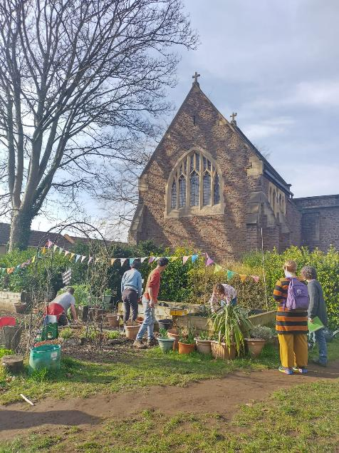
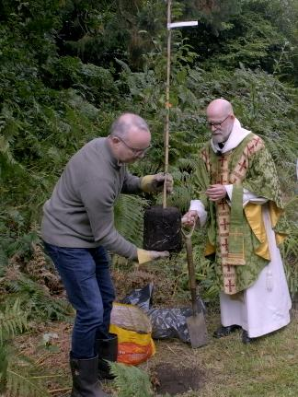
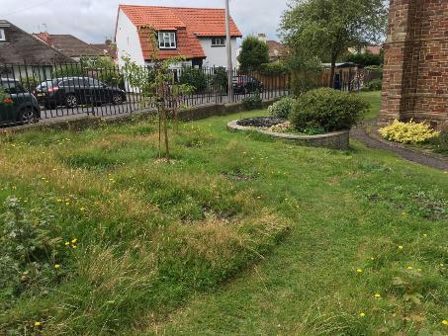

Slide 13
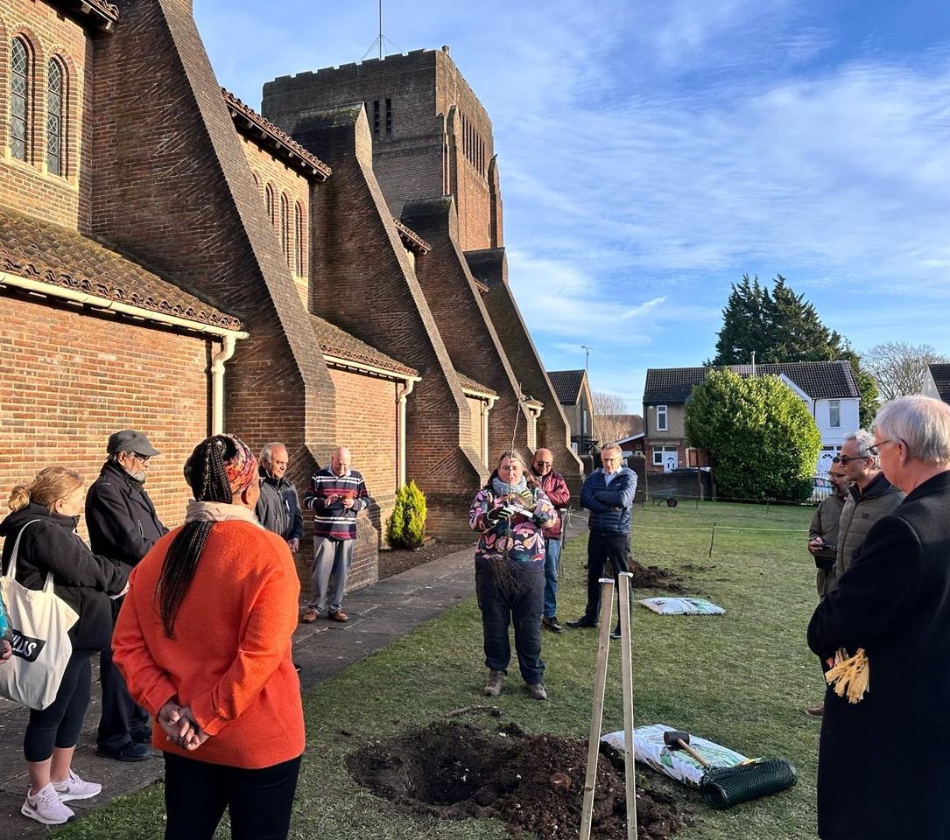
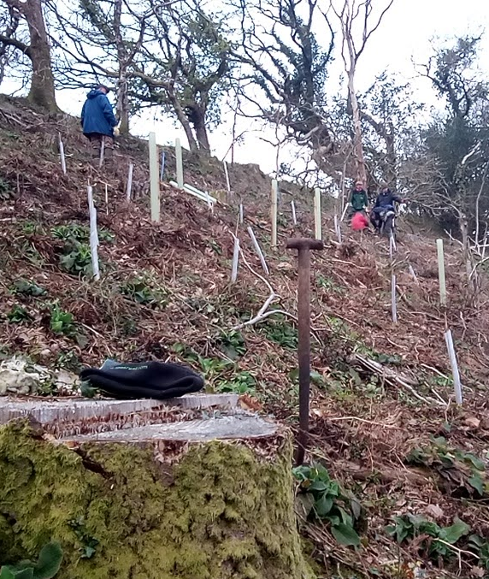
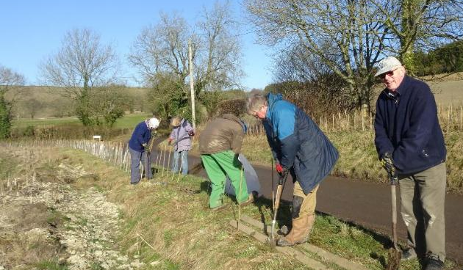
Growing Trees
Growing suitable trees in gardens
Regenerating temperate rainforest
Partnering with local landowners to grow more trees

Slide 14
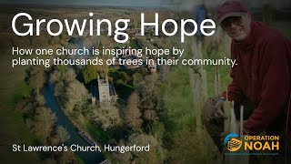

Slide 15
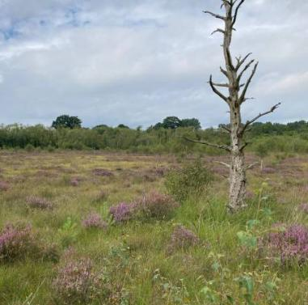
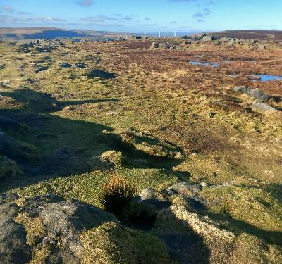
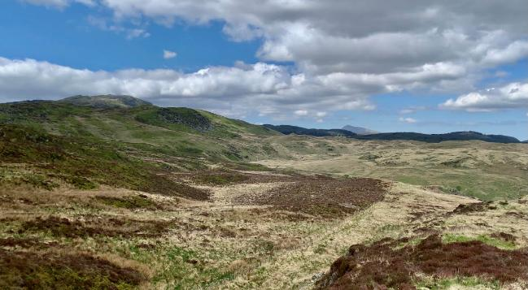
Protecting peatland
Supporting peat restoration work locally
Ensuring compost is peat-free (& plants)
Join campaigns to ban horticultural peat

Slide 16
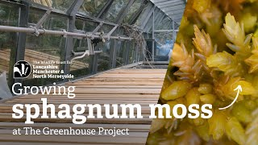

Slide 17
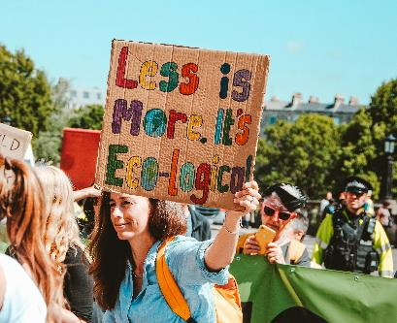
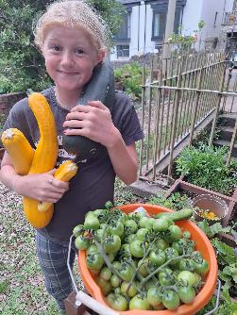
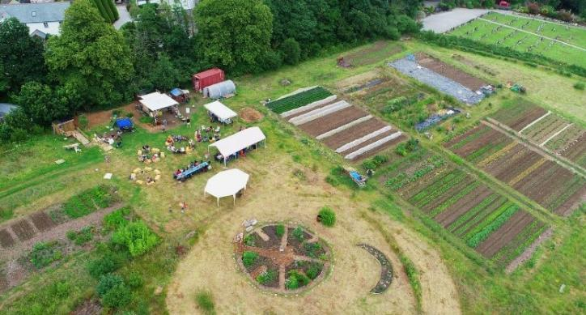
Supporting farm net zero
Reduce food waste
Support nature-friendly farmers
Support community farm projects on church land

Slide 18
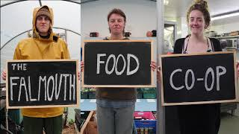

Slide 19
How can you get involved
Become an ‘Operation Noah Champion’
Inspire your church to do more with its land – use our resources and share inspiring examples with church leadership
Support other local projects working to enhance biodiversity and take climate action
Support our work
Notes:
The Background to ‘Faith Motivated – Hope Inspired – Science Informed’

